Slide 1
SCTE Chesapeake Chapter
RPHY Power-hour
September 2018

Slide 2

Rob Crowe
Field Applications Engineer
Antronix
RobCrowe@antronix.com
(347) 596-9847
Performance. Broadband. Innovation

Slide 3
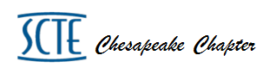
Let’s quickly review all the growth, drivers and changes that have been going on in CATV
Some of these terms may come up during the R-Phy portion (Another Change) so it may help to build a quick foundation
It may also help explain that many MSO’s are at different stages in their system development and there is no ‘One Size Fits All’ method
At the end of the day, we have to deliver an exceptional experience for a fair price
This presentation merely attempts to help explain R-Phy and is not intended to be pro or con any particular strategy

Slide 4
What’s the Main Driver for all the Changes?
More Bandwidth per Subscriber
How has this been accomplished?
Added Hardware in Hubs / H.E’s reducing S.G. size
Freed up Spectrum – VOD/SVOD/All Digital
Added more DOCSIS Ch’s – Bonded
Throughout there were Node Splits….. (Some added Return Only Splits via Digital Return)
Plant Upgrades for Expanded Spectrum
Driving Fiber Deeper for Less {Homes/Node} = (Smaller S.G.’s)
D 3.1 (The “.1” is an injustice given its revolutionary nature)
If expanding Forward why not expand Return-85M? 200M?
How about IP based delivery
The List Goes on Right?........

Slide 5
So What Started Happening?
Some were running out of Hub/H.E. Space
Having Problems with Critical Infrastructure-Power, UPS, GEN, Cooling
From This Some Converged or what is Referred to as CCAP
*Converged Cable Access Platform
This is Simply ‘One Box’ doing the functions of CMTS, VOD, SVOD
For Those That Converged This May Have Solved Their Space Issues for Now (Some Power and Cooling as well)
Others May be Concerned with Licenses or May Wish to Fully use their Existing VOD/SVOD Platforms….’Rust in Place’
What’s the Point of All of This?..........

Slide 6
There is No Single Right or Best Way

Slide 7
QAM Sales the last 20 years
High Tech Growth…
  Consumption has grown 40% per year
  Standard has changed about every 3 years.
  Industry has changed the footprint/placement three times.
  Sell the same capacity over and over again and 40% growth on top of that…
Power of Silicon
  Density and Power consumption improvements
  Pricing… started at $10K per channel… RPHY less than $10 per channel.
Most platforms are full spectrum 3.1 PHY capable…
Let’s move it out of the hub and put it in the node …

Slide 8
This moving from Hub to Node is Rphy?
Remote Phy (Rphy) is a Distributed Access Architecture (DAA) that moves parts of the Cable Modem Termination System (CMTS) and Edge QAM modulator OR a combined Converged Cable Access Platform (CCAP) system from the Hub or Headend to the network edge (Node).
Main Types of DAA
. Remote PHY
. Remote Mac – PHY (Two Types – Remote CCAP or Remote CMTS + Divided EQAM)
. Split Mac
Note – Remote PHY is a Leading Option right now and will remain our focus

Slide 9
By RPhy Definition let’s clear up a few points
It is Possible to do R-Phy whether Converged or Not
Many consider R-Phy easier and neater if Converged First, but it is NOT required
Likewise Node + 0 is NOT required for R-Phy
It is True that some are doing Node + 0 with immediate Plans for R-Phy, but Full Duplex down the road weighed into their thought process
Some are waiting to see how R-MacPhy Progresses *(and standards set)
Still Plenty want to eventually do a form of DAA for some or all of the reasons discussed BUT in addition… move towards ‘Virtualization’
More to come on Virtualization…..

Slide 10
Fast Facts
RPHY - largest change in OSP cable since AM fiber was introduced in 1992. (26 years ago)
  All other HFC changes have been incremental and evolutionary.
HFC… the good blend of Fiber and Copper.
  Fiber is the best medium for signal transportation but struggles to split/share
  Coax is the best medium for sharing/splitting but struggles to transport.
RPHY (simplest terms) - conversion of Fiber from AM to IP.
  Never bet against IP

Slide 11
Visual of RPHY?
Data Center / Head End
Hub
Node
Home
Video QAM Platform
Analog Tx
Node
Docsis Cable Modem
CMTS
Dig. Tx/Rx
Remote PHY
Router
Data/
Video D3.1 PHY
ROADM
Routing
Mac Control & Provision
Data QAM Module
Analog Rx
Dig. Tx/
Rx
Coax Plant
Server Based Software MAC and Provisioning
Phase 3: Virtual CCAP
Push Routing, MAC and Provisioning to Data Center
Ethernet from Data Center to Node
Phase 1: CCAP
Data & Video Converged
DOCSIS 3.1
Phase 2: Remote PHY
Move PHY to Node
Ethernet deep in Network
Cloud
CMTS

Slide 12
Why RPHY??
Enables less space and less power in the Hub,
Enables cloud CMTS
Higher bit-rate for D3.1
Longer reach optics
Enables sharing commercial and residential plants
Enables HFC fiber to become a full service IP network
Enables FDX
More SG per fiber
More wavelengths
Lower plant maintenance costs
Lower optics costs (10G)
Simpler fiber design rules
Replaces RF Combining with Ethernet switching
Provides more bandwidth.

Slide 13
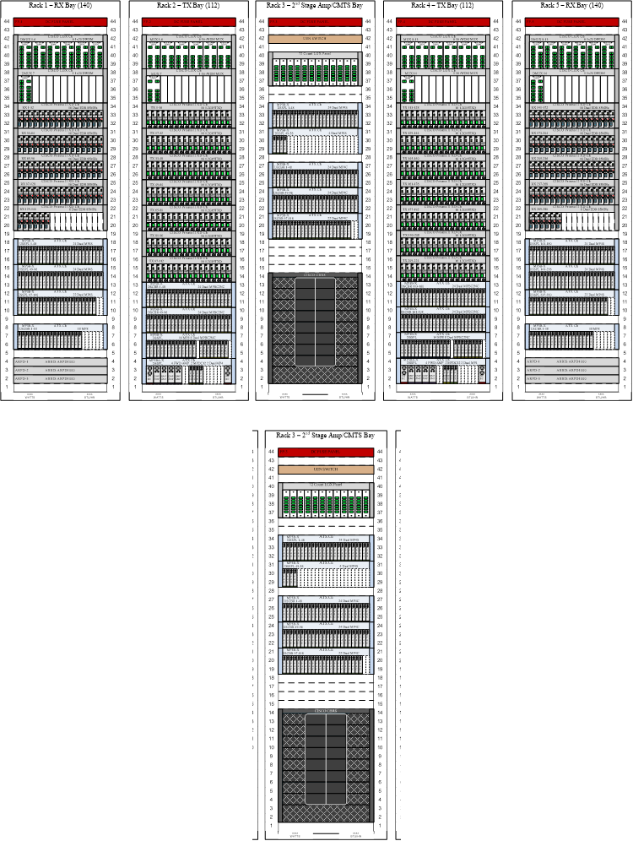
Why RPHY?? (Let’s play fact check)
Enables less space and less power in the Hub
Mostly true - Very significant if you are out of space… less so if you have plenty. Diagram to the right is based on today’s channels per service group..
Power savings can be elusive… power is being moved from Hub to Node and there is savings in A/C costs but that is countered by inefficiency in distributing power in the plant.

Slide 14
Why RPHY??
Enables cloud CMTS
Definitely true –
Is cloud CMTS worth the effort? Cloud CMTS is complex and requires a commitment to cloud based services.
Most (if not all) successful cloud based service providers develop, own, and operate their own software.
Will the cloud based model for feature velocity be successful with a 3rd party software provider?

Slide 15
Why RPHY??
Higher bit-rate for D3.1
Partially true – MER will improve significantly but will that change enable significant bit rate improvement? Answer… maybe. Most 3.1 systems are already enjoying 1024 and sometime 4096 modulation without RPHY. Standard allows for higher modulation index but silicon today is limited to 4096.
Please allow me to stray from RPhy briefly to dive deeper……

Slide 16
Let’s Review Higher Bit Rate Deeper
The Better SNR Performance and Possible Higher Qam Modulation Rates wouldn’t be Much Value without D3.1
Remember D3.0 was SC-Qam 256q Max Mod Rate
We have heard Spectral Efficiency (SE) so let’s quickly define and make sure it’s meaning is clear

Slide 17
So What is ‘Spectral Efficiency’
Basically, it’s how efficient can a piece of Spectrum be used to transmit information from one point to another
There is a ‘Hard Limit’ to how much information can be transmitted in a given BW commonly known as the ‘Shannon Limit’
The Ultimate Goal is to ‘Cost Effectively’ hit the ‘Shannon Limit’
Let’s Calculate Spectral Efficiency for D3.0 as a point of reference

Slide 18
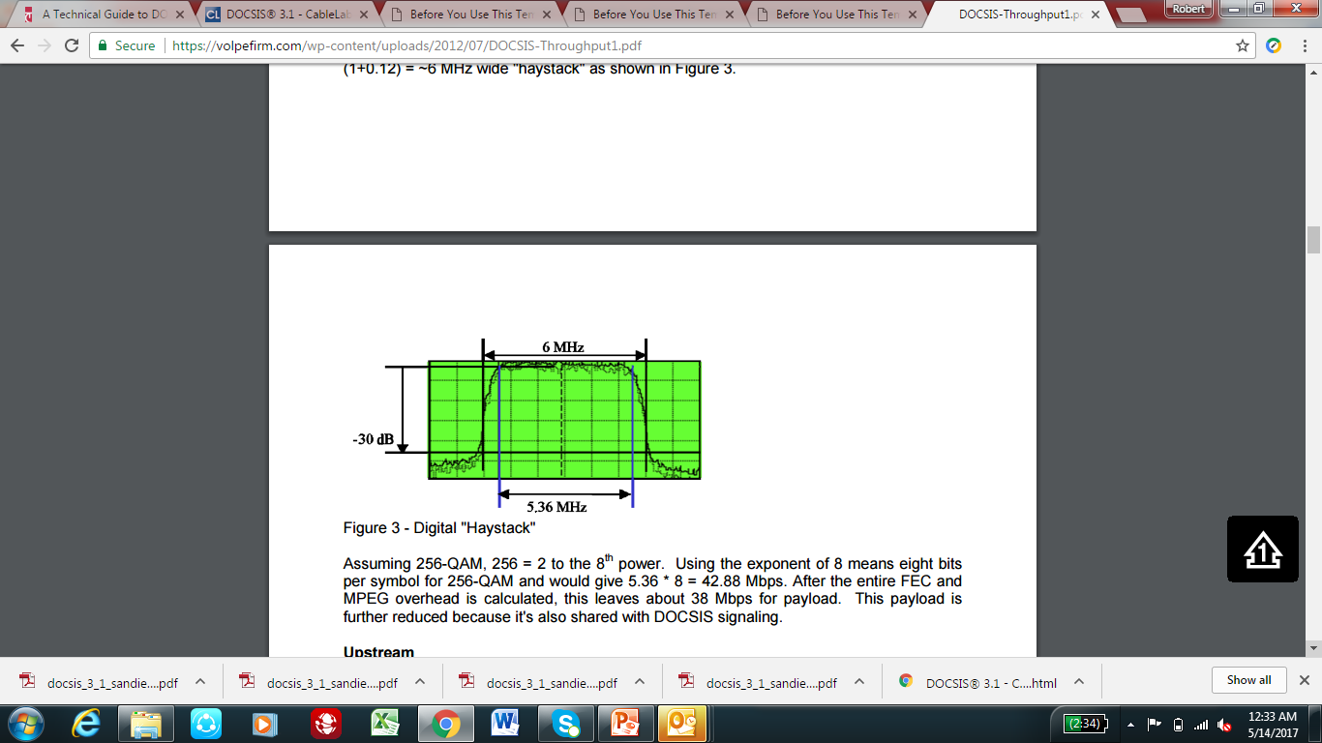
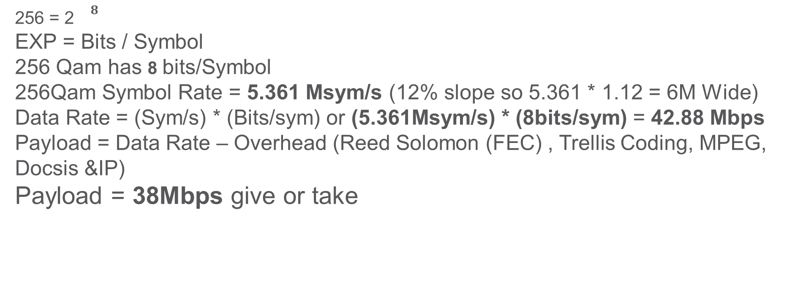
D3.0 256 SC-QAM Data Payload
(STEP–1)
256 = 2${}^{8}$
EXP = Bits / Symbol
256 Qam has 8 bits/Symbol
256Qam Symbol Rate = 5.361 Msym/s (12% slope so 5.361 * 1.12 = 6M Wide)
Data Rate = (Sym/s) * (Bits/sym) or (5.361Msym/s) * (8bits/sym) = 42.88 Mbps
Payload = Data Rate – Overhead (Reed Solomon (FEC) , Trellis Coding, MPEG, Docsis &IP)
Payload = 38Mbps give or take

Slide 19
‘Payload’ of 256 Qam = 38 Mbps
Spectral Efficiency = Payload / BW
38Mbps / 6MHz = 6.33b/s/Hz *(bits / sec / Hz)
Spectral Efficiency (SE) of D3.0
Note – Bonding enables ‘bigger pipe’ but SE remains the same

Slide 20
Obviously if we increase Modulation Rate we increase SE
How Much SNR Improvement Digital Fiber and DAA will achieve is very dependent on Node Output
Most feel their Analog Link is in the 38-39 MER Range
The MER Improvement From DAA Drops if the Node is at Max Output Due to Limitations of GaN chip sets
From This We Can See

Slide 21
192M OFDM (no exclusions) 96M OFDMA (no exclusions)
Downstream Upstream
MODULATION | SUBCARRIER SPACING
 | 25KhZ | 50KhZ
(QAM) | (Gbps) | (Gbps)
256 | 1.26 | 1.2
512 | 1.42 | 1.35
1024 | 1.58 | 1.5
2048 | 1.73 | 1.65
4096 | 1.89 | 1.8
8192 | 2.05 | 1.96
16384 | 2.21 | 2.11
MODULATION | SUBCARRIER SPACING
 | 25KhZ | 50KhZ
(QAM) | (Gbps) | (Gbps)
64 | 0.47 | 0.46
128 | 0.55 | 0.53
256 | 0.63 | 0.61
512 | 0.71 | 0.69
1024 | 0.78 | 0.76
2048 | 0.86 | 0.84
4096 | 0.94 | 0.91
Ok- Back to RPhy…. but migrating to RPhy solely for increased B.W. may not be cost effective. Many are deploying or planning to, for multiple benefits.

Slide 22
Why RPHY??
Longer reach optics
True but is it significant?… unless you plan on hub consolidation longer fiber reach may not be necessary, or at least at the moment.
Enables sharing commercial and residential plants
True – IP Ethernet fiber can carry residential and commercial wavelengths on the same fiber. Clearly, the more readily plant is available at an attractive price for commercial services the better the odds to grow that revenue.
Enables HFC fiber to become a full service IP network
Partially true – As an IP based fiber network, the communication path is available without a transponder.

Slide 23
Why RPHY??
Enables FDX
True, obviously at the moment actual deployment and measurements are down the road.
More SG per fiber
Mostly not true… more SG per wavelength would require an Ethernet switch in the field.
More wavelengths
True, Standards based IP based Ethernet optics are well understood
Lower plant maintenance costs
TBD… it should be. Less actives, but more complex electronics in each active, easier to setup (assuming automation becomes are reality)

Slide 24
Why RPHY??
Lower optics costs (10G)
Not yet but should be soon. Standards based 10G optics are on a steeper cost reduction curve than analog optics.
Simpler fiber design rules
Partially true – definitely simpler than BC/NC overlay systems but not as simple as single wavelength 1310 systems.
Replaces RF Combining with Ethernet switching
True – RF techs will require training on IP.
Provides more bandwidth.
Mostly not true – by itself RPHY may not provide more bandwidth, when combined with fiber deep of better 3.1 modulation than yes it will help.

Slide 25
. HFC first – Many want Gradual targeted path to R-Phy
. Power Consumption + (Savings / Disabled Port(s))
. How Many Splits *So initially when remaining analog HFC 2 x 2 may be max split
. OOB Support (55-1, 55-2, NDF-NDR)
. Output Level – Chip-set, MER Improvement of R-Phy @ [x] level
. RPD Inter-ops - Open platform so any RPD talks with any Core
. How many RPD’s and/or RPD Segmentation
. Output Coax Ports
. Lobby Camera mixing
. Digital Return Proprietary, 42M may need upgrade; forego for Rphy??
. Stat Mon, Intelligence, Self Setting (Balancing with no pads/EQ’s)
* Some manufactures focused on producing a very clean, streamlined design with greater attention on auto set-up, intelligence and R-Phy and did not waste R&D energies on 4 x 4 segmentation; at a time when fiber deep(er) is moving away from 4 x 4 anyway. They will be 2 x 2 though, and you simply stay with what you have for 4 x 4 and slowly phase out the other nodes 2 x 2 or less. You will still pull obsoleted nodes out of the field and can use those parts to support 4 x 4. STOP repairing old obsolete equipment, throwing good money at the bad!
Even though some MSO’s may not have immediate plans for DAA, their Nodes may be obsolete and they are looking to replace.
Most want R-Phy capable
Some common Considerations:

Slide 26
Who are some of The Names in This Space?
Major R-Phy Nodes:

Slide 27
Conclusions…
RPHY is the largest change in the outside plant in recent history.
RPHY is a great compliment to other initiatives (fiber deep, hub consolidation)
Digital (standards based IP – Ethernet optics) is a technology I would never bet against.
FDX will take a little longer to implement than estimated.
Cloud based services (works for Amazon and Google) not sure about CMTS yet.

Slide 28
Questions?

