Slide 1

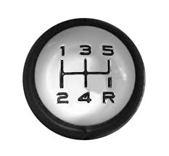




DOCSIS® 3.1 – An Overview
Ron Hranac
Technical Leader
Cisco Systems
Bruce Currivan
Technical Director
Broadcom

Slide 2

DOCSIS Background
Data-Over-Cable Service Interface Specifications
DOCSIS 1.0 gave us standards-based interoperability, which means “certified” cable modems from multiple vendors work with “qualified” cable modem termination systems (CMTSs) from multiple vendors.
DOCSIS 1.1 added a number of features, including quality of service (QoS), more robust scheduling, packet classification and other enhancements that facilitate voice and non-best effort data services.
One upstream channel, typically 1.6 MHz or 3.2 MHz bandwidth
One 6 MHz bandwidth downstream channel, 64- or 256-QAM
5 MHz
42 MHz
88 MHz
860 MHz
1002 MHz
DOCSIS upstream
DOCSIS downstream

Slide 3
DOCSIS Background
DOCSIS 1.x supported per-channel downstream data rates of 30.34 Mbps (64-QAM) and 42.88 Mbps (256-QAM) in a 6 MHz channel bandwidth, and several upstream data rates, ranging from a low of 320 kbps to a high of 10.24 Mbps. It also supported two upstream modulation formats – quadrature phase shift keying (QPSK) and 16-QAM – as well as five upstream RF channel bandwidths.
DOCSIS 1.1 added some enhancement to upstream transmission robustness, using 8-tap adaptive pre-equalization.
Channel bandwidth, MHz | Symbol rate, ksym/sec | QPSK raw data rate, Mbps | QPSK nominal data rate, Mbps | 16-QAM raw data rate, Mbps | 16-QAM nominal data rate, Mbps
0.200 | 160 | 0.32 | ~0.3 | 0.64 | ~0.6
0.400 | 320 | 0.64 | ~0.6 | 1.28 | ~1.2
0.800 | 640 | 1.28 | ~1.2 | 2.56 | ~2.4
1.60 | 1,280 | 2.56 | ~2.3 | 5.12 | ~4.8
3.20 | 2,560 | 5.12 | ~4.6 | 10.24 | ~9.0

Slide 4
DOCSIS Background
DOCSIS 2.0: Downstream channel bandwidth and data rates unchanged from DOCSIS 1.x, but higher upstream data throughput per RF channel, up to 30.72 Mbps
DOCSIS 2.0 supported 64-QAM in the upstream, plus 8-QAM and 32-QAM – and optionally supported 128-QAM trellis coded modulation (TCM) encoded modulations for S-CDMA channels – and up to 6.4 MHz channel bandwidth.
  To facilitate more robust upstream data transmission, DOCSIS 2.0 introduced advanced PHY (24-tap pre-equalizer, improved FEC, ingress cancellation, direct sampled RF in burst receiver, etc.)
One upstream channel, up to 6.4 MHz bandwidth
One 6 MHz bandwidth downstream channel, 64- or 256-QAM
5 MHz
42 MHz
88 MHz
860 MHz
1002 MHz
DOCSIS upstream
DOCSIS downstream

Slide 5
DOCSIS Background
DOCSIS 3.0 retained a downstream channel bandwidth of 6 MHz and upstream channel bandwidths up to 6.4 MHz, and introduced channel bonding
  Logically bond multiple channels to increase data throughput
  e.g., 4 bonded downstream channels: 100+ Mbps
RF spectrum changes – Downstream increased to 1 GHz and upstream increased from 5 MHz to as high as 85 MHz (optional)
DOCSIS 1.x / 2.0 cable modems can reside on same system
..
Multiple bonded upstream channels
Multiple bonded 6 MHz bandwidth downstream channels, 64- or 256-QAM
.....
5 MHz
85 MHz
108 MHz
860 MHz
1002 MHz
DOCSIS upstream
DOCSIS downstream

Slide 6
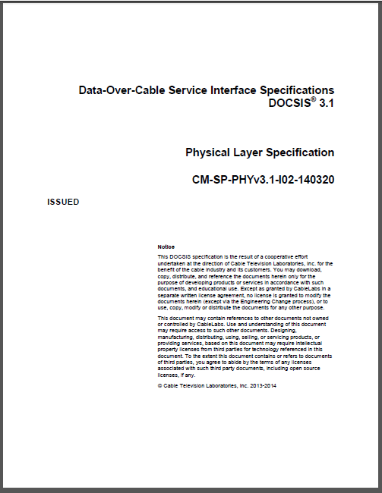
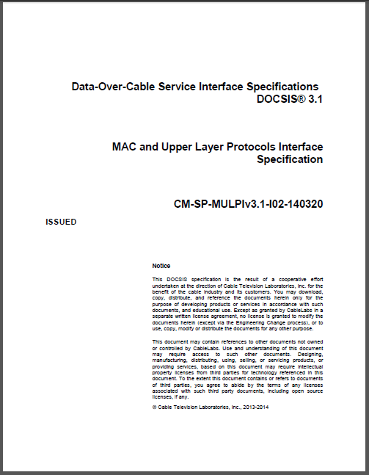
What is DOCSIS 3.1?
Answer: The latest Data Over Cable Service Interface Specifications
DOCSIS 3.1 is the latest Data Over Cable Service Interface Specifications. CableLabs® released version I01 of the new spec in late October, 2013. The latest version is I06, released June, 2015.
All DOCSIS 3.1 specifications including MAC and Upper Layer Protocols Interface Specification (MULPI), Cable Modem Operations Support System Interface Specification (OSSI), Physical Layer Specification (PHY), CCAP™ Operations Support System Interface Specification, and Security Specification have been publicly released.
  (available for download at CableLabs’ web site: http://www.cablelabs.com)
DOCSIS 3.1 specifications became an international standard in early December 2014: ETSI TS 103 311

Slide 7

Why DOCSIS 3.1?
Why not just continue with DOCSIS 3.0?
  DOCSIS 3.0 could scale to gigabit-class speeds
  DOCSIS 3.1 will scale better, and is more spectrally efficient than today’s single carrier quadrature amplitude modulation (SC-QAM) technology
According to CableLabs:
  “DOCSIS 3.1 technology will enable a new generation of cable services and help operators continue to meet consumer demand for high speed connections and sophisticated applications, positioning them to be the providers of choice in their markets.”

Slide 8

Why DOCSIS 3.1?
Goals
  Achieve 10+ Gbps in the downstream
  Achieve 1+ Gbps in the upstream
  Backwards compatibility with DOCSIS 3.0, 2.0, & 1.1
  Better spectral efficiency (more bps/Hz)
Technology
  OFDM, OFDMA, LDPC
  Expanded downstream and upstream spectrum
  Improved energy efficiency
This will allow DOCSIS 3.1 to support services competitive with FTTH.
Deployable in today’s HFC networks!

Slide 9
Improved performance
New physical layer (PHY) technology: OFDM (orthogonal frequency division multiplex) and OFDMA (orthogonal frequency division multiple access)
  Better spectral efficiency than SC-QAM
Better forward error correction (FEC): low density parity check (LDPC)
  More powerful than the Viterbi/Reed-Solomon FEC used in earlier versions of DOCSIS
Higher modulation orders
  Up to 4096-QAM in the downstream and upstream, optional to 16384-QAM in the downstream
Expanded downstream and upstream RF spectrum usage
  Downstream: 258 MHz to 1218 MHz, optional to 1794 MHz (and 108 MHz on lower end)
  Upstream: 5 MHz to 85 MHz (mandatory), optional to as high as 204 MHz
Multiple modulation profiles
  Different modulation orders for different modems

Slide 10
RF transmit power
Downstream RF transmit power
  CMTS power is configured by power per CEA channel and number of occupied CEA channels for each OFDM channel. For each OFDM channel, the total power is power per CEA channel + 10log₁₀(number of occupied CEA channels) for that OFDM channel.
  Required power per channel for N_{eq}' channels combined onto a single RF port:
  Required power in dBmV per channel = 60 – ceil [3.6*log₂(N*)] dBmV
Input to the modem
  Total input power < 40 dBmV, 54 MHz to 1.794 GHz (negligible input power outside this frequency range)
  Level range = -9 dBmV to +21 dBmV (in 24 MHz occupied bandwidth)
  (equivalent PSD to -15 dBmV to +15 dBmV per 6 MHz SC-QAM)

Slide 11
RF transmit power
Upstream RF transmit power
  All DOCSIS 3.0 requirements still in place for operating DOCSIS 3.0 mode
  DOCSIS 3.1 maximum transmit average power (not peak) is required to be at least +65 dBmV
  As with DOCSIS 3.0, modem vendors may design their products for higher modem transmit power capability, but all spurious emissions requirements (dBc) must still be met even at higher transmit power levels
  DOCSIS 3.1 has minimum transmit power limits related to transmit grant bandwidth
  No less than +17 dBmV with 1.6 MHz grant

Slide 12
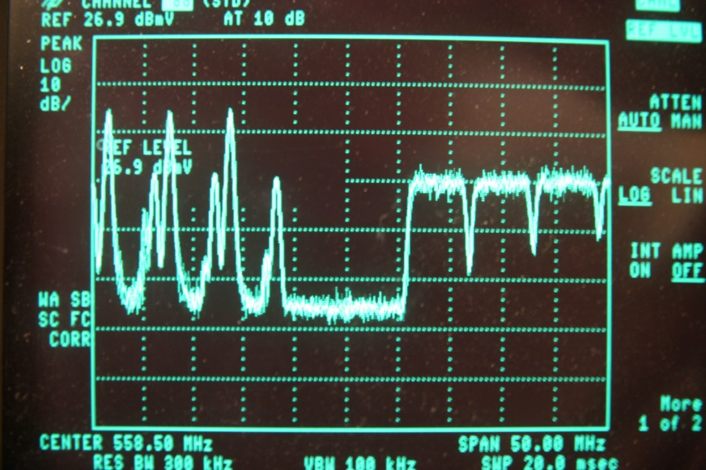
DOCSIS 3.1 PHY: OFDM
Cable networks (and radio and TV stations in the over-the-air environment) have for decades used frequency division multiplexing (FDM) to allow the transmission of several RF signals through the same length of coaxial cable at the same time
  Each RF signal is on a separate frequency, or more specifically, assigned to its own channel slot
Analog TV signals
Digital signals

Slide 13





What is OFDM?
Orthogonal frequency division multiplexing (OFDM) is used in the DOCSIS 3.1 downstream.
Up to 7800 narrow subcarriers make up one OFDM channel.
Each subcarrier carries a small percentage of the total data payload at a very low data rate.
The upstream counterpart is called OFDMA, or orthogonal frequency division multiple access.
  Don’t forget time division multiple access (TDMA) is also used with OFDMA to share the upstream channel.
OFDM is a proven technology that enjoys widespread use:

Slide 14
OFDM versus SC-QAM
One SC-QAM signal per channel

Slide 15
DOCSIS 3.1 OFDM channel width
With OFDM, the concept of a 6 MHz or 8 MHz channel is no longer necessary.
DOCSIS 3.1 OFDM channel bandwidth is flexible
  Downstream channel bandwidth: Minimum of 24 MHz to maximum of 192 MHz
  Upstream channel bandwidth: Minimum encompassed spectrum of 6.4 MHz to a maximum encompassed spectrum of 95 MHz

Slide 16
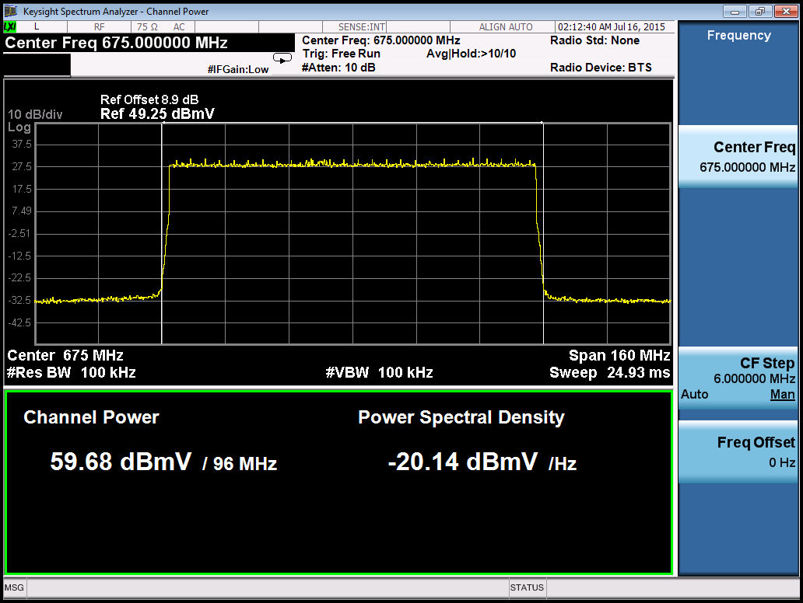
DOCSIS 3.1 downstream OFDM channel (96 MHz bandwidth) on a spectrum analyzer
Pilots evenly spaced across channel
PHY link channel (PLC)

Slide 17
OFDM: orthogonal subcarriers
For improved spectral efficiency, the subcarriers in an OFDM or OFDMA channel overlap one another.
  Why don’t they interfere with one another?
The subcarriers are orthogonal.
  “Orthogonal” in this case means the subcarriers are independent such that there is no interaction between them despite the overlap in frequency.
  Orthogonal subcarriers have exactly an integer number of cycles in the symbol interval.

Slide 18
OFDM: orthogonal subcarriers
The subcarrier spacing in DOCSIS 3.1 is 25 kHz or 50 kHz
1/T_{U}
1.0
0.8
0.6
Amplitude
0.4
0.2
0
Frequency
- 0.2
- 0.4
The peak of one subcarrier’s response falls on the nulls of the other subcarriers’ responses, ideally resulting in no interference between the subcarriers. (Note: T_{U} is the FFT duration or “useful symbol duration” – that is, 20 µs or 40 µs in the case of DOCSIS 3.1.)

Slide 19
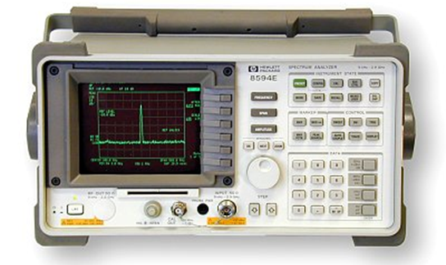
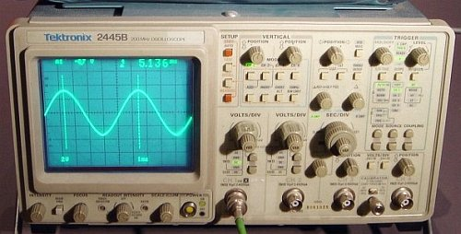
OFDM: time and frequency domains
An oscilloscope shows a signal in the time domain – amplitude versus time.
A spectrum analyzer displays a signal in the frequency domain – amplitude versus frequency.
Sine wave on oscilloscope
Sine wave on spectrum analyzer

Slide 20
What is the fast Fourier transform?
The fast Fourier transform (FFT) is a fast way to compute the discrete Fourier transform (DFT).
  600/1200x faster than direct computation for length 4096/8192.
The DFT is a way of expressing any waveform in terms of sine waves.
  DFT: Break down a complex signal into many sine waves. Used in the OFDM receiver.
  Inverse DFT (IDFT): Sum many sine waves to construct a complex signal. Used in the OFDM transmitter.
Some folks are a little lax and use the abbreviations FFT and DFT almost interchangeably. ☺

Slide 21
DFT matrix
To apply the DFT just multiply by a matrix.
Multiplying by this matrix converts between the time and frequency domains, and performs modulation and demodulation.

Slide 22
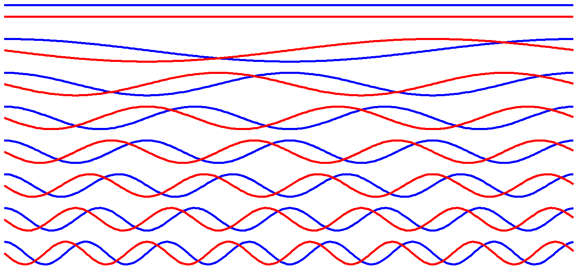
DFT matrix
The DFT matrix contains rows of sine waves.
Each row has a slightly higher frequency (contains one more full cycle) than the previous row.
Red = sine
Blue = cosine
N = 16
(half of rows shown)
The IDFT matrix is identical except its sines are negated.

Slide 23
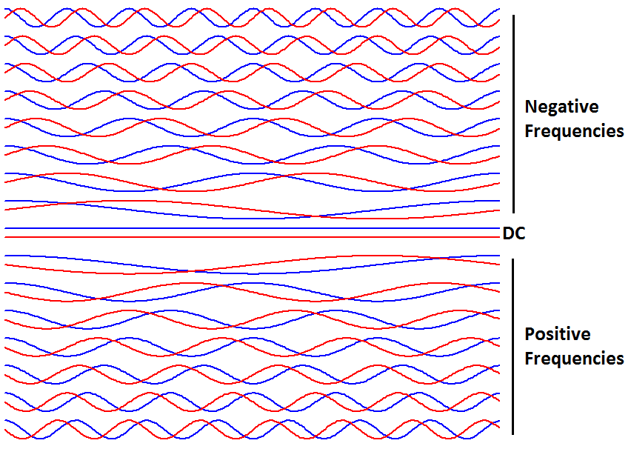
Full DFT matrix
“Negative” frequencies = below RF center frequency
DC represents RF center freq
Positive freqs = above RF center freq
Sine lags/leads cosine for positive/ negative frequency

Slide 24

How big is the DOCSIS 3.1 DFT matrix?
The DFT matrix for DOCSIS 3.1 contains 4096 or 8192 sine and cosine waves.
The most we can clearly show on this slide is 64 rows.

Slide 25

How big is the DOCSIS 3.1 DFT matrix?
The DFT matrix on this slide has 256 rows,
still nowhere near 4096 or 8192 for DOCSIS 3.1.

Slide 26
Transmitter: Inverse DFT
IDFT is the equivalent of this:
QAM modulator for 1st subcarrier
Start with 4096 QAM symbols.
Multiply by the IDFT matrix.
  Actually use IFFT which is 600 times faster to give same answer!
This gives the equivalent of 4096 individual QAM modulators summed together – very powerful!
Send this summed signal over the cable channel.
QAM modulator for 2nd subcarrier
QAM modulator for 3rd subcarrier
QAM modulator for 4th subcarrier
QAM modulator for 4095th subcarrier
QAM modulator for 4096th subcarrier

Slide 27
Receiver: DFT
DFT is the equivalent of this:
QAM receiver for 1st subcarrier
We receive a signal from the cable channel and multiply by the DFT matrix (using FFT algorithm for speed).
The result tells how the signal correlates with each of the sine waves in the DFT matrix.
This gives us back the original QAM data.
The single matrix multiply is equivalent to
4096 individual QAM receivers!
QAM receiver for 2nd subcarrier
QAM receiver for 3rd subcarrier
QAM receiver for 4th subcarrier
QAM receiver for 4095th subcarrier
QAM receiver for 4096th subcarrier

Slide 28
Don’t forget receiver synchronization
To get the transmitter IFFT and receiver FFT to line up, we need to synchronize the receiver to the transmitter.
Timing: Adjust symbol timing so the FFT starts at the right time.
  Cyclic prefix: To make timing easier, the transmitter repeats part of the signal. This also allows time for channel echoes to die out.
Frequency: Adjust receiver to the correct center frequency.
  Continuous pilots: Some subcarriers carry no data, and are used to measure frequency offset.
Equalization: Adjust amplitude and phase of each subcarrier to remove channel effects.
  Scattered pilots: Carry no data, visit each subcarrier location once every 128 symbols, used to measure channel response.

Slide 29
Anatomy of a downstream OFDM channel
25 kHz subcarrier spacing: 7600 subcarriers (called “8K FFT”)
50 kHz subcarrier spacing: 3800 subcarriers (called “4K FFT”)
190 MHz encompassed spectrum
192 MHz channel bandwidth, including 1 MHz wide guard band on each end.
Since the guard bands in this example total 2 MHz out of 192 MHz, the equivalent excess bandwidth or “alpha” is (2/192) x 100 ≈ 1%, compared to 12% for DOCSIS 3.0 and earlier 256-QAM SC-QAM.

Slide 30
Anatomy of a downstream OFDM channel
25 kHz subcarrier spacing: 7600 subcarriers (called “8K FFT”)
50 kHz subcarrier spacing: 3800 subcarriers (called “4K FFT”)
190 MHz encompassed spectrum
192 MHz channel bandwidth, including 1 MHz wide guard band on each end.
Although the excess bandwidth shown here is only about 1%, indicating very high raw spectral efficiency, OFDM does require other overhead to aid the receiver in acquiring the signal. This overhead includes the PHY link channel and pilots, which are discussed in the following slides, and next codeword pointer.

Slide 31
Anatomy of a downstream OFDM channel
1 MHz guard band
25 kHz subcarrier spacing: 7600 subcarriers
50 kHz subcarrier spacing: 3800 subcarriers
1 MHz guard band
190 MHz
192 MHz channel bandwidth, including 1 MHz wide guard band on each end
Note: The guard bands shown in these examples use the minimum bandwidth supported. Actual guard band bandwidth may be greater than 1 MHz.

Slide 32

Anatomy of a downstream OFDM channel
Exclusion bands may be created within an OFDM channel for problems such as strong in-channel ingress (e.g., LTE interference).
Exclusion band
An exclusion band is a set of contiguous subcarriers within the OFDM channel bandwidth that are set to zero-value by the transmitter to avoid interference or to accommodate co-existing transmissions such as legacy SC-QAM signals.

Slide 33
Anatomy of a downstream OFDM channel
Exclusion bands also may be created within an OFDM channel for the carriage of legacy SC-QAM signals.
190 MHz
192 MHz channel bandwidth, including 1 MHz wide guard band on each end
An exclusion band is a set of contiguous subcarriers within the OFDM channel bandwidth that are set to zero-value by the transmitter to avoid interference or to accommodate co-existing transmissions such as legacy SC-QAM signals.

Slide 34
Anatomy of a downstream OFDM channel
As an alternative to an exclusion band in that part of an OFDM channel experiencing interference, the bit loading may be changed to allow continued carriage of data, but using a more robust lower modulation order.

Slide 35
Anatomy of a downstream OFDM channel
400 kHz bandwidth PHY link channel (PLC), shown here in red, is centered within a 6 MHz contiguous portion of the OFDM channel (yellow) that has no exclusions.
The PLC conveys physical layer parameters from the CMTS to the cable modem
The cable operator chooses where in the OFDM channel to place the PLC. Ideally, the PLC should be located in a known clean part of the OFDM channel that is not susceptible to ingress, direct pickup, and other types of interference.
190 MHz
192 MHz channel bandwidth, including 1 MHz wide guard band on each end
The lowest frequency subcarrier that bounds the 6 MHz portion of the OFDM channel in which the PLC is located is centered on a 1 MHz grid.

Slide 36
Anatomy of a downstream OFDM channel
400 kHz PLC
PHY link channel:
8 subcarriers (50 kHz spacing)
16 subcarriers (25 kHz spacing)
Modulation: 16-QAM
6 MHz
190 MHz
192 MHz channel bandwidth, including 1 MHz wide guard band on each end

Slide 37
Anatomy of a downstream OFDM channel
Subcarriers called continuous pilots are more or less evenly distributed throughout the OFDM channel, and are boosted 6 dB relative to other subcarriers. There can be anywhere from 16 to 128 continuous pilots in an OFDM channel, including 8 in the PLC band (next slide).
6 dB
190 MHz
192 MHz channel bandwidth, including 1 MHz wide guard band on each end
Continuous pilots occur at the same frequency in every OFDM symbol, and are used for frequency and phase tracking. Continuous pilots do not carry data (they are BPSK modulated with a pseudo-random sequence, though).

Slide 38
Anatomy of a downstream OFDM channel
400 kHz PLC
Continuous pilots in PLC band:
Four pairs of predefined continuous pilots are placed symmetrically around the PLC.
6 dB
6 MHz
190 MHz
192 MHz channel bandwidth, including 1 MHz wide guard band on each end

Slide 39
Anatomy of a downstream OFDM channel
Other subcarriers called scattered pilots (shown here in light blue) occur at different frequency locations in different symbols. From symbol to symbol, scattered pilots are shifted by one subcarrier position in the increasing direction of the frequency axis, so the scattered pilots visit every subcarrier location every 128 symbols. Scattered pilots also are boosted 6 dB.
6 dB
190 MHz
192 MHz channel bandwidth, including 1 MHz wide guard band on each end
Scattered pilots occur every 128 subcarriers (but not in the PLC band or in exclusion bands), and are used primarily for estimation of channel frequency response as part of the equalization process. Scattered pilots do not carry data (they are BPSK modulated with a pseudo-random sequence, though).

Slide 40
Anatomy of a downstream OFDM channel
Other subcarriers called scattered pilots (shown here in light blue) occur at different frequency locations in different symbols. From symbol to symbol, scattered pilots are shifted by one subcarrier position in the increasing direction of the frequency axis, so the scattered pilots visit every subcarrier location every 128 symbols. Scattered pilots also are boosted 6 dB.
6 dB
190 MHz
192 MHz channel bandwidth, including 1 MHz wide guard band on each end
In the PLC band, the PLC preamble acts as a stand-in for the scattered pilots. That is, the scattered pilot sequence is synchronized so that it lands on the PLC preamble locations, so the receiver can use the known values of the PLC preamble to aid it in acquisition at those locations, thereby getting the same benefit as if the scattered pilots had been placed there.

Slide 41
Anatomy of a downstream OFDM channel
The DOCSIS 3.1 downstream OFDM channel can transmit broadcast, multicast, or unicast traffic on the downstream subcarriers to all modems, multiple modems, or a single modem, respectively. When multiple downstream profiles are used, different modems may receive different sets of subcarriers within an OFDM symbol, because a single OFDM symbol can contain multiple profiles with multiple codewords. If a given modem does not have sufficient SNR for 4096-QAM, for example, it is not required to receive the profile using 4096-QAM.
190 MHz
192 MHz channel bandwidth, including 1 MHz wide guard band on each end
Notes:
In the upstream – which uses OFDMA - certain subcarriers are assigned to certain modems (using minislots and MAPs and so forth), but in the downstream there is no directly analogous process.
At the PHY layer, the DOCSIS 3.1 downstream is broadcast - all subcarriers are physically heard by all modems. (Some subcarriers may be more impaired for certain modems, maybe even to the point of being unusable, but all subcarriers are a part of the same channel which all modems listen to.)
At the convergence layer, D3.1 uses the next codeword pointer (NCP) subcarriers/message blocks to dynamically assign subcarriers to a profile. This is NOT the same as assigning subcarriers to a modem, because a profile is generally heard by multiple modems (possibly all modems, for instance profile A). Each modem will have its own personal list of profiles it is supposed to listen to, and it will choose which subcarriers to decode based on that list.
The MAC layer is what finally gets us to the individual modem - the MAC extracts DOCSIS frames/Ethernet packets which have labels or addresses to tell modems which packets are for them. At this point there is no concept of specific subcarriers having carried packets to specific modems - everything got interleaved and FEC-decoded and so forth - the modem decoded the entire profile and then picked out packets that belonged to it.
So there is no actual assignment of subcarriers to modems - instead there is: broadcasting of subcarriers at the PHY layer; assignment of subcarriers to profiles (which are broadcast or multicast) at the convergence layer; addressing of packets to modems at the MAC layer.

Slide 42
Anatomy of an upstream OFDMA channel
25 kHz subcarrier spacing: 3800 subcarriers (4K FFT)
50 kHz subcarrier spacing: 1900 subcarriers (2K FFT)
95 MHz encompassed spectrum

Slide 43
Anatomy of an upstream OFDMA channel
500 kHz guard band
25 kHz subcarrier spacing: 3800 subcarriers (4K FFT)
50 kHz subcarrier spacing: 1900 subcarriers (2K FFT)
500 kHz guard band
95 MHz encompassed spectrum

Slide 44
Anatomy of an upstream OFDMA channel
Exclusion bands may be created within an OFDMA channel for problems such as strong ingress (e.g., shortwave, CB radio), or for the carriage of legacy SC-QAM signals.
95 MHz encompassed spectrum
An exclusion band is a set of contiguous subcarriers within the OFDMA channel bandwidth that are set to zero-value by the transmitter to avoid interference or to accommodate co-existing transmissions such as legacy SC-QAM signals.

Slide 45
Anatomy of an upstream OFDMA channel
Exclusion bands may be created within an OFDMA channel for problems such as strong ingress (e.g., shortwave, CB radio), or for the carriage of legacy SC-QAM signals.
95 MHz encompassed spectrum
An exclusion band is a set of contiguous subcarriers within the OFDMA channel bandwidth that are set to zero-value by the transmitter to avoid interference or to accommodate co-existing transmissions such as legacy SC-QAM signals.

Slide 46
Anatomy of an upstream OFDMA channel
Exclusion bands may be created within an OFDMA channel for problems such as strong ingress (e.g., shortwave, CB radio), or for the carriage of legacy SC-QAM signals.
95 MHz encompassed spectrum
An exclusion band is a set of contiguous subcarriers within the OFDMA channel bandwidth that are set to zero-value by the transmitter to avoid interference or to accommodate co-existing transmissions such as legacy SC-QAM signals.

Slide 47
Anatomy of an upstream OFDMA channel
OFDMA is a multi-user version of OFDM, and assigns subsets of subcarriers to individual CMs.
In this example, five modems are transmitting simultaneously within the same 96 MHz bandwidth OFDMA channel. The different colors represent subsets of the channel’s subcarriers assigned to each modem.
CM2
CM3
CM5
CM1
CM4
95 MHz encompassed spectrum

Slide 48
Anatomy of an upstream OFDMA channel
Minislots comprise groups of 8 or 16 subcarriers (8 subcarriers per minislot shown). A modem may transmit one or more minislots per burst.
There are two types of minislots for each minislot size: edge and body.
An edge minislot is the first minislot in an upstream burst; the first minislot after an exclusion band, or after one or more contiguous skipped subcarriers, or after a zero valued minislot; and the first minislot of an OFDMA frame that is not a zero valued minislot.
All others are body minislots.
Tx 1
Tx 2
Tx 3
Tx 4
Edge
Body
Body
Body
Body
Edge
Body
Body
Body
Edge
Edge
Body
Body
Body
Body
Body
6.4 MHz
95 MHz encompassed spectrum

Slide 49
Anatomy of an upstream OFDMA channel
Subcarriers called pilots do not carry data. They are BPSK modulated with a pseudo-random binary sequence known to the receiver, and are used to adapt to channel conditions and frequency offset.
Upstream pilots are boosted by approximately 4.7 dB relative to other subcarriers.
There are seven pilot patterns defined for each minislot size (Pattern #1 for 8-subcarrier minislots shown).
4.7 dB
Edge
Body
Body
Body
Body
Edge
Body
Body
Body
Edge
Edge
Body
Body
Body
Body
Body
6.4 MHz
95 MHz encompassed spectrum

Slide 50
Anatomy of an upstream OFDMA channel
Subcarriers called complementary pilots (used in the upstream only) do carry data, but at a lower modulation order than other subcarriers (e.g., if data subcarriers are 256-QAM, the complementary pilots are 16-QAM).
The CMTS receiver MAY use complementary pilots to enhance its signal processing, such improving the accuracy of center frequency offset acquisition.
Complementary pilots are also boosted by approximately 4.7 dB relative to other upstream subcarriers.
Pattern #1 for 8-subcarrier minislots shown.
4.7 dB
Edge
Body
Body
Body
Body
Edge
Body
Body
Body
Edge
Edge
Body
Body
Body
Body
Body
6.4 MHz
95 MHz encompassed spectrum
Note: Subslots, not shown in these examples, carry REQ messages (7 bytes or 56 bits long) using QPSK.

Slide 51
Higher modulation orders: downstream
 | CMTS downstream transmit | Cable modem downstream receive | Bits per symbol
MUST | 16-QAM | 16-QAM | 4
MUST | 64-QAM | 64-QAM | 6
MUST | 128-QAM | 128-QAM | 7
MUST | 256-QAM | 256-QAM | 8
MUST | 512-QAM | 512-QAM | 9
MUST | 1024-QAM | 1024-QAM | 10
MUST | 2048-QAM | 2048-QAM | 11
MUST | 4096-QAM | 4096-QAM | 12
MAY | 8192-QAM | 8192-QAM | 13
MAY | 16384-QAM | 16384-QAM | 14
Higher orders than DOCSIS 3.0

Slide 52
Higher modulation orders: upstream
 | Cable modem upstream transmit | CMTS upstream receive | Bits per symbol
MUST | QPSK | QPSK | 2
MUST | 8-QAM | 8-QAM | 3
MUST | 16-QAM | 16-QAM | 4
MUST | 32-QAM | 32-QAM | 5
MUST | 64-QAM | 64-QAM | 6
MUST | 128-QAM | 128-QAM | 7
MUST | 256-QAM | 256-QAM | 8
MUST | 512-QAM | 512-QAM | 9
MUST | 1024-QAM | 1024-QAM | 10
MUST | 2048-QAM | — | 11
MUST | 4096-QAM | — | 12
SHOULD | — | 2048-QAM | 11
SHOULD | — | 4096-QAM | 12
Higher orders than DOCSIS 3.0 ATDMA

Slide 53
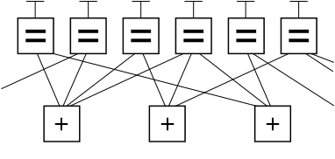
LDPC FEC
DOCSIS 3.1 uses a form of FEC known as LDPC
LDPC = low density parity check
  The concept of LDPC was introduced by Robert G. Gallager in his 1960 Sc.D. thesis at MIT (Gallager’s thesis was published by the MIT Press as a monograph in 1963)
  Because of encoder and decoder complexity, it wasn’t practical to implement LDPC until relatively recently
BCH (Bose-Chaudhuri-Hocquengham) outer code corrects residual errors in downstream

Slide 54
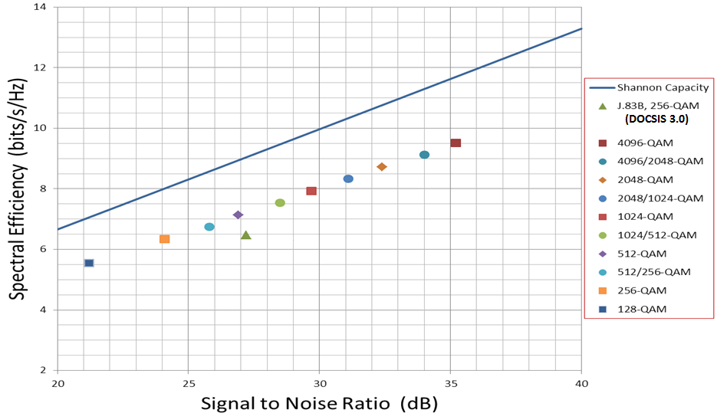
FEC: improved SNR and throughput
~3 dB SNR improvement over D3.0 using 256-QAM
4096-QAM gives ~50% throughput improvement over 256-QAM
1.5x
DOCSIS 3.0
3 dB
Source: R. Prodan
(Spec allows 3-6 dB higher SNR for implementation and channel effects)

Slide 55
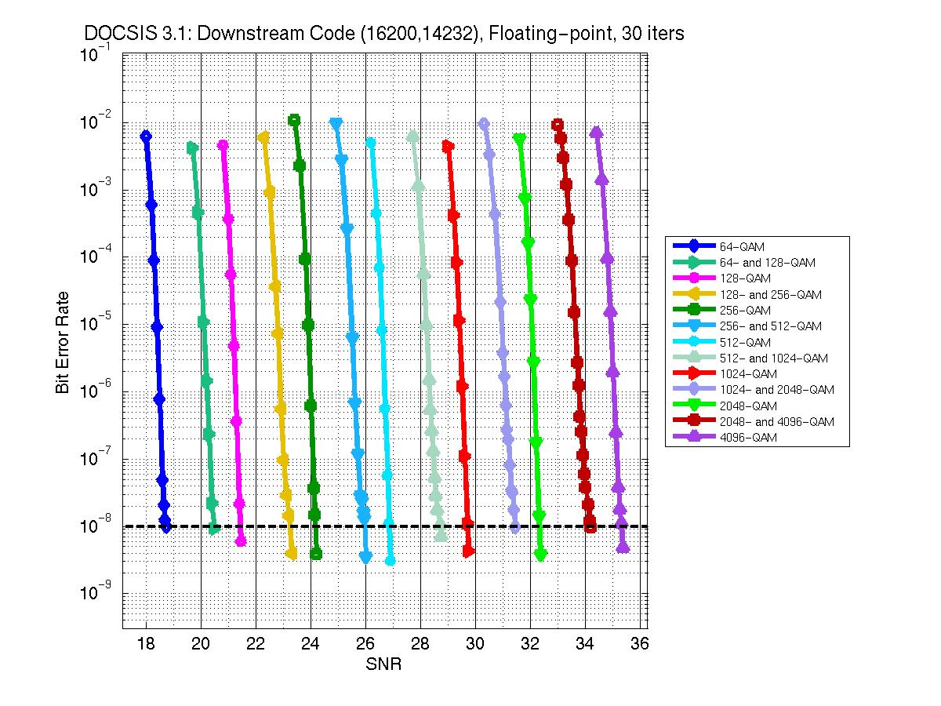
FEC flexibility
Pick modulation based on SNR
Source: R. Prodan, SCTE Expo 2014

Slide 56
DOCSIS 3.1 downstream frequency usage
108 MHz
258 MHz
750 MHz
1002 MHz
1218 MHz
1794 MHz
54 MHz
DOCSIS 3.1 downstream: 258 MHz to 1218 MHz

Slide 57
DOCSIS 3.1 downstream frequency usage
108 MHz
258 MHz
860 MHz
1002 MHz
1218 MHz
1794 MHz
54 MHz
DOCSIS 3.1 downstream: 258 MHz to 1218 MHz
  Optional 108 MHz lower end
  Optional 1794 MHz upper end
Must support a minimum of two 192 MHz-wide OFDM channels in the downstream

Slide 58
DOCSIS 3.1 upstream frequency usage
5 MHz
42 MHz
65 MHz
85 MHz
117 MHz
204 MHz
258 MHz
DOCSIS 3.1 upstream: 5 MHz to as high as 204 MHz
  Also must support 5 MHz to 42 MHz, 5 MHz to 65 MHz, 5 MHz to 85 MHz (mandatory), and 5 MHz to 117 MHz
Must support a minimum of two full OFDMA channels (95 MHz encompassed spectrum each) in the upstream

Slide 59
DOCSIS 3.1 upstream frequency usage
Upstream SC-QAM
Downstream
5 MHz
42 MHz
54 MHz
88 MHz
108 MHz
Using time division duplexing, legacy upstream SC-QAM signals can share the return spectrum with full-bandwidth OFDMA.
  A DOCSIS 3.0 (or earlier) modem transmits when DOCSIS 3.1 modems are not transmitting

Slide 60
DOCSIS 3.1 upstream frequency usage
Upstream OFDMA
Downstream
5 MHz
42 MHz
54 MHz
88 MHz
108 MHz
Using time division duplexing, legacy upstream SC-QAM signals can share the return spectrum with full-bandwidth OFDMA.
  A DOCSIS 3.1 modem transmits when legacy modems are not transmitting

Slide 61
DOCSIS 3.1 upstream frequency usage
Upstream OFDMA + SC-QAM
Downstream
5 MHz
42 MHz
54 MHz
88 MHz
108 MHz
Alternatively, the OFDMA channel can be configured with an exclusion band to accommodate legacy SC-QAM channels, while the OFDMA signal occupies the rest of the spectrum.
  This would allow legacy and DOCSIS 3.1 modems to use the spectrum simultaneously

Slide 62
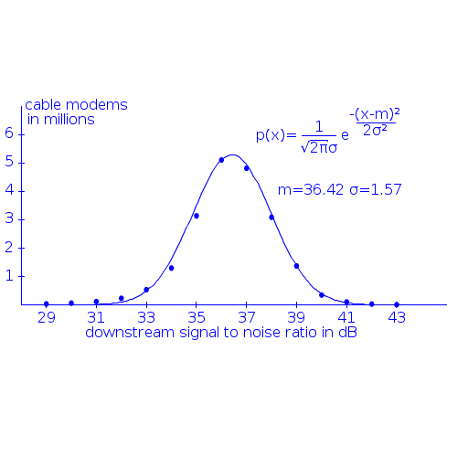
Plant performance?
One cable operator’s analysis showed at least 8 dB variation in downstream SNR (MER) among millions of modems:
Example DOCSIS 3.1 SNR/MER requirements
Modulation order | MER/SNR
256-QAM | 29~30 dB
512-QAM | 31~33 dB
1024-QAM | 34~36 dB
2048-QAM | 37~39 dB
4096-QAM | 40~42 dB

Slide 63
Downstream profiles
Downstream profiles support the transmission of different modulation orders to different modems
The downstream profiles feature is always used, even if the feature is configured for just one profile
Multiple downstream profiles could enable operators to leverage SNR/MER variation to improve system capacity
Example with four profiles:
  A: Worst (say, mostly 256-QAM)
  B: Average (say, mostly 1024-QAM)
  C: Better (say, mostly 2048-QAM)
  D: Best (say, mostly 4096-QAM)
Worst Case
Average
Case
Better
Case
Best
Case

Slide 64
Approximate downstream speeds
Single 192 MHz OFDM channel (full channel, no exclusions)
Modulation order | 25 kHz subcarrier spacing | 50 kHz subcarrier spacing
256-QAM | 1.26 Gbps | 1.20 Gbps
512-QAM | 1.42 Gbps | 1.35 Gbps
1024-QAM | 1.58 Gbps | 1.50 Gbps
2048-QAM | 1.73 Gbps | 1.65 Gbps
4096-QAM | 1.89 Gbps | 1.80 Gbps
8192-QAM | 2.05 Gbps | 1.96 Gbps
16384-QAM | 2.21 Gbps | 2.11 Gbps
8192-QAM and 16384-QAM are optional, and may not be practical in most of today’s plants

Slide 65
Approximate upstream speeds
Single 95 MHz encompassed spectrum OFDMA channel (full channel, no exclusions)
Modulation order | 25 kHz subcarrier spacing | 50 kHz subcarrier spacing
64-QAM | 0.47 Gbps | 0.46 Gbps
128-QAM | 0.55 Gbps | 0.53 Gbps
256-QAM | 0.63 Gbps | 0.61 Gbps
512-QAM | 0.71 Gbps | 0.69 Gbps
1024-QAM | 0.78 Gbps | 0.76 Gbps
2048-QAM | 0.86 Gbps | 0.84 Gbps
4096-QAM | 0.94 Gbps | 0.91 Gbps

Slide 66
DOCSIS 3.1 deployment example
Legacy digital video SC-QAM signals
Legacy DOCSIS SC-QAM signals
OFDM
One 192 MHz OFDM channel
The OFDM channel can be located in available spectrum
Windowing can be used to sharpen the spectral edges of the OFDM signal
Legacy DOCSIS SC-QAM and DOCSIS 3.1 OFDM can be bonded

Slide 67
DOCSIS 3.1 deployment example
Legacy digital video SC-QAM signals
Legacy DOCSIS SC-QAM signals
in exclusion band within OFDM channel
Legacy digital video SC-QAM signals
OFDM
OFDM
One 192 MHz OFDM channel
Excluded subcarriers (“nulling”) can be used to facilitate coexistence of an OFDM channel with legacy SC-QAM signals
The OFDM subcarriers can be located in available spectrum
As before, legacy DOCSIS SC-QAM and DOCSIS 3.1 OFDM can be bonded

Slide 68
DOCSIS 3.1 deployment example
OFDMA and legacy SC-QAM
OOB
OFDM
OFDM
OFDM
(future)
Legacy SC-QAM Digital Video
5 MHz
258 MHz
750 MHz
870 MHz
1002 MHz
1218 MHz
85 MHz
108 MHz
192 MHz
192 MHz
192 MHz
Upgrade split to 5-85 MHz upstream, 108 MHz* to 1002 MHz (or 1218 MHz) downstream
  Legacy SC-QAM digital video in the 108 MHz to ~600 MHz spectrum
  Two 192 MHz wide OFDM signals from 618 MHz to 1002 MHz (optional third OFDM >1 GHz)
  Mix of OFDMA and legacy SC-QAM in upstream
  * Note: Downstream out-of-band for set-tops may be carried in the 102~108 MHz range (avoid local FM), although it could be anywhere in the 102 MHz to 130 MHz range, assuming available spectrum.

Slide 69
DOCSIS 3.1 deployment example
OFDMA and legacy SC-QAM
Legacy SC-QAM digital video
OOB
OFDM
OFDM
OFDM
OFDM
OFDM
5 MHz
258 MHz
750 MHz
870 MHz
1002 MHz
1218 MHz
85 MHz
108 MHz
192 MHz
192 MHz
192 MHz
192 MHz
192 MHz
Upgrade split to 5-85 MHz upstream, 108 MHz* to 1218 MHz downstream
  Legacy SC-QAM digital video in the 108 MHz to 258 MHz spectrum
  Five 192 MHz wide OFDM signals from 258 MHz to 1218 MHz
  Mix of OFDMA and legacy SC-QAM in upstream
  * Note: Downstream out-of-band for set-tops may be carried in the 102~108 MHz range (avoid local FM), although it could be anywhere in the 102 MHz to 130 MHz range, assuming available spectrum.

Slide 70
Full spectrum DOCSIS 3.1 deployment example
Two 95 MHz OFDMA channels
OFDM
OFDM
OFDM
OFDM
OFDM
OFDM
OFDM
5 MHz
204 MHz
258 MHz
750 MHz
870 MHz
1002 MHz
1218 MHz
...to 1794 MHz
192 MHz
192 MHz
192 MHz
192 MHz
192 MHz
Upgrade split to 5-204 MHz upstream, 258 MHz to 1218 MHz downstream (optionally to 1794 MHz)
  Five 192 MHz wide OFDM signals from 258 MHz to 1218 MHz
  Optionally another three 192 MHz wide OFDM signals between 1218 MHz and 1794 MHz
  Two 95 MHz encompassed spectrum OFDMA signals in the 5 MHz to 204 MHz spectrum

Slide 71

Backwards compatibility
DOCSIS 3.1 devices will simultaneously support legacy SC-QAM channels and OFDM channels
Devices will support bonding between OFDM and SC-QAM in order to aggregate that capacity and provide an incremental and orderly migration
The time division nature of the existing DOCSIS upstream allows for legacy and OFDMA to be time multiplexed
Allows a gradual and evolutionary introduction of DOCSIS 3.1

Slide 72
DOCSIS 3.1 proactive network maintenance
PNM designed for DOCSIS 3.1 from the ground up to provide “test points” in the CMTS and cable modem
  Characterize and troubleshoot HFC plant
  Support remote proactive troubleshooting of plant faults
  Improve reliability and maximize throughput from well-maintained plant

Slide 73
DOCSIS 3.1 test points for HFC plant
Cable plant is “device under test”
PNM measurements are virtual “test equipment”

Slide 74
Downstream PNM “hooks”
Downstream symbol capture: Capture OFDM symbol at input and output of plant, solve for plant response
Wideband spectrum analysis: Spectrum analyzer in cable modem
Channel estimate coefficients: Downstream equalizer response
Constellation display: QAM constellation cluster
Receive modulation error ratio (RxMER) per subcarrier: MER (SNR) vs frequency
FEC statistics: Correctable and uncorrectable codewords
Histogram: Signal distribution revealing nonlinearities in plant such as laser clipping
Received power: RF power received at cable modem

Slide 75
Downstream PNM measurements vs use case

Slide 76
Downstream symbol capture
Ordinary OFDM symbol captured by CMTS at input to cable plant
Same received symbol captured by cable modem after cable plant
With known input and output samples, channel can be characterized, including linear and nonlinear effects
Fast spectrum measurement, magnitude, group delay, compression, laser clipping, CPD, ingress, noise under carrier, plant leakage …
Trigger message block (MULPI 6.5.5) allows modem and CMTS to capture the same symbol

Slide 77
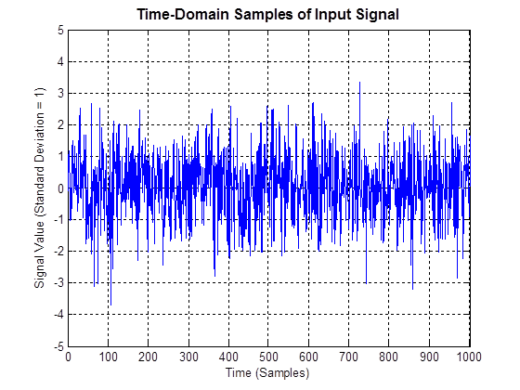
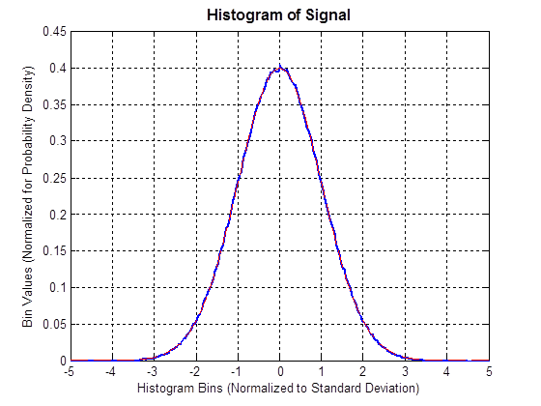
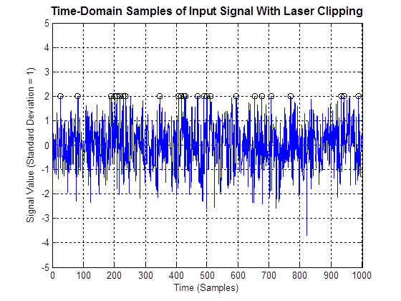
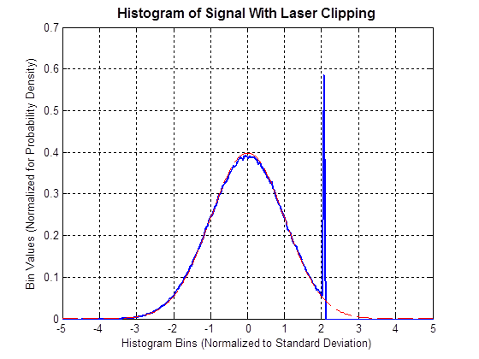
Histogram of Laser Clipping
Normal OFDM signal has Gaussian-shaped histogram
(a)
(b)
Laser clipping at y = 2
Laser clipping causes one tail to be chopped off and replaced with spike
(a)
(b)
Time domain samples
Histogram

Slide 78
Spectrum of upstream band at cable modem
Extension to D3.1 PNM
Problem: Upstream noise funnels to single point at CMTS making it difficult to locate source
Solution: Measure spectrum of upstream band at each cable modem
  Provides noise source location capability
  Noise originating in house, drop or plant will have identifiable spectrum signature at cable modems and CMTS

Slide 79
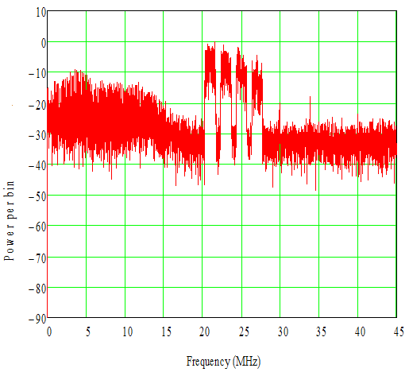
Upstream spectrum at cable modem with damaged cable shielding
TX spectrum rolloff
Impulse noise
Possible switching power supply interference
Raised noise floor

Slide 80
Upstream PNM “hooks”
Capture for active and quiet probe: Capture known probe symbol (or empty slot) at output of plant, solve for plant response (or noise floor)
Triggered spectrum analysis: Spectrum analyzer synchronized with upstream timeslots
Impulse noise statistics: Burst/impulse noise level and duration
Equalizer coefficients: Pre- and post-equalizer responses
FEC statistics: Error-free, unreliable, and corrected codewords
Histogram: Signal distribution revealing nonlinearities in plant such as laser clipping
Channel power: Power received at CMTS (ranging offset)
RxMER per subcarrier: MER (SNR) vs frequency

Slide 81
Upstream PNM measurements vs use case

Slide 82
Summary
New PHY layer: OFDM, OFDMA, and LDPC
Higher modulation orders
New spectrum usage options
Takes DOCSIS to full-spectrum capability
Cost-effectively scales to 10+ Gbps in the downstream, 1+ Gbps in the upstream
FTTH equivalent at lower price point on an existing HFC plant
Deployable in today’s HFC networks
Notes:
http://www.cisco.com/en/US/netsol/ns791/networking_solutions_solution_category.html#~resources

Slide 83
Questions and discussion
Ron Hranac
Technical Leader
Cisco Systems
Bruce Currivan
Technical Director
Broadcom

Slide 84
Useful references
“What is OFDM?” by Ron Hranac; (November 2012 Communications Technology)
  http://www.scte.org/TechnicalColumns/12-11-30%20what%20is%20ofdm.pdf
SCTE Rocky Mountain Chapter seminar (April 17, 2014): “Introduction to DOCSIS 3.1”
  http://www.scte-rockymountain.org/information-central/seminar-videos
DOCSIS 3.1 spec
  http://www.cablelabs.com/
Notes:
http://www.cisco.com/en/US/netsol/ns791/networking_solutions_solution_category.html#~resources

Slide 85
Downstream encompassed spectrum example
25 kHz subcarrier spacing: 7600 subcarriers (8K FFT)
50 kHz subcarrier spacing: 3800 subcarriers (4K FFT)
190 MHz encompassed spectrum
192 MHz channel bandwidth, including 1 MHz wide guard band on each end

Slide 86
A closer look at the guard bands
1 MHz guard band
25 kHz subcarrier spacing: 7600 subcarriers (8K FFT)
50 kHz subcarrier spacing: 3800 subcarriers (4K FFT)
1 MHz guard band
190 MHz encompassed spectrum
192 MHz channel bandwidth, including 1 MHz wide guard band on each end
The 1 MHz guard bands shown are the minimum bandwidth supported. Guard bands may be wider depending on configuration.

Slide 87
Downstream occupied bandwidth example (1)
25 kHz subcarrier spacing: 7600 subcarriers (8K FFT)
50 kHz subcarrier spacing: 3800 subcarriers (4K FFT)
OFDM channel aligned with CEA channel grid
190 MHz encompassed spectrum
192 MHz channel bandwidth, including 1 MHz wide guard band on each end
192 MHz occupied bandwidth
(32 CEA ch x 6 MHz = 192 MHz)

Slide 88
Downstream occupied bandwidth example (2)
25 kHz subcarrier spacing: 7600 subcarriers (8K FFT)
50 kHz subcarrier spacing: 3800 subcarriers (4K FFT)
Entire OFDM channel offset +3 MHz
190 MHz encompassed spectrum
192 MHz channel bandwidth, including 1 MHz wide guard band on each end
198 MHz occupied bandwidth
(33 CEA ch x 6 MHz = 198 MHz)

Slide 89
Downstream modulated spectrum example (1)
25 kHz subcarrier spacing: 7600 subcarriers (8K FFT)
50 kHz subcarrier spacing: 3800 subcarriers (4K FFT)
190 MHz encompassed spectrum
192 MHz channel bandwidth, including 1 MHz wide guard band on each end
190 MHz modulated spectrum

Slide 90
Downstream modulated spectrum example (2)
25 kHz subcarrier spacing: 6800 subcarriers (8K FFT)
50 kHz subcarrier spacing: 3400 subcarriers (4K FFT)
20 MHz exclusion band
190 MHz encompassed spectrum
192 MHz channel bandwidth, including 1 MHz wide guard band on each end, and 20 MHz exclusion band
170 MHz modulated spectrum

Slide 91
Downstream occupied bandwidth example (3)
25 kHz subcarrier spacing: 6800 subcarriers (8K FFT)
50 kHz subcarrier spacing: 3400 subcarriers (4K FFT)
20 MHz exclusion band
This exclusion band comprises
a gap equal to three 6 MHz-wide CEA channel slots plus a 1 MHz guard band on each edge of the exclusion band
18 MHz
190 MHz encompassed spectrum
192 MHz channel bandwidth, including 1 MHz wide guard band on each end, and 20 MHz exclusion band
170 MHz modulated spectrum
174 MHz occupied bandwidth
(29 CEA ch x 6 MHz = 174 MHz)

Slide 92
24 MHz bandwidth channel example
25 kHz subcarrier spacing: 880 subcarriers (8K FFT)
50 kHz subcarrier spacing: 440 subcarriers (4K FFT)
22 MHz encompassed spectrum
24 MHz channel bandwidth, including 1 MHz wide guard band on each end
22 MHz modulated spectrum
24 MHz occupied bandwidth
(4 CEA ch x 6 MHz = 24 MHz)

