Slide 1
Comcast’s Network Architecture
Jorge Salinger
VP, Access Architecture
jorge_salinger@cable.comcast.com

Slide 2
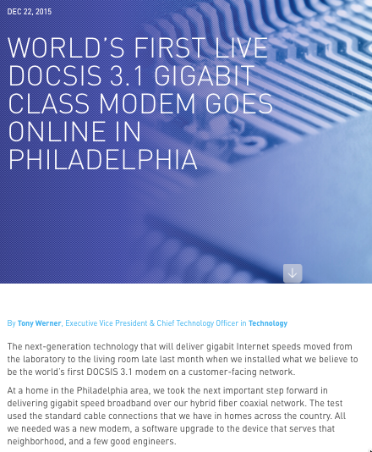
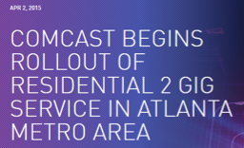
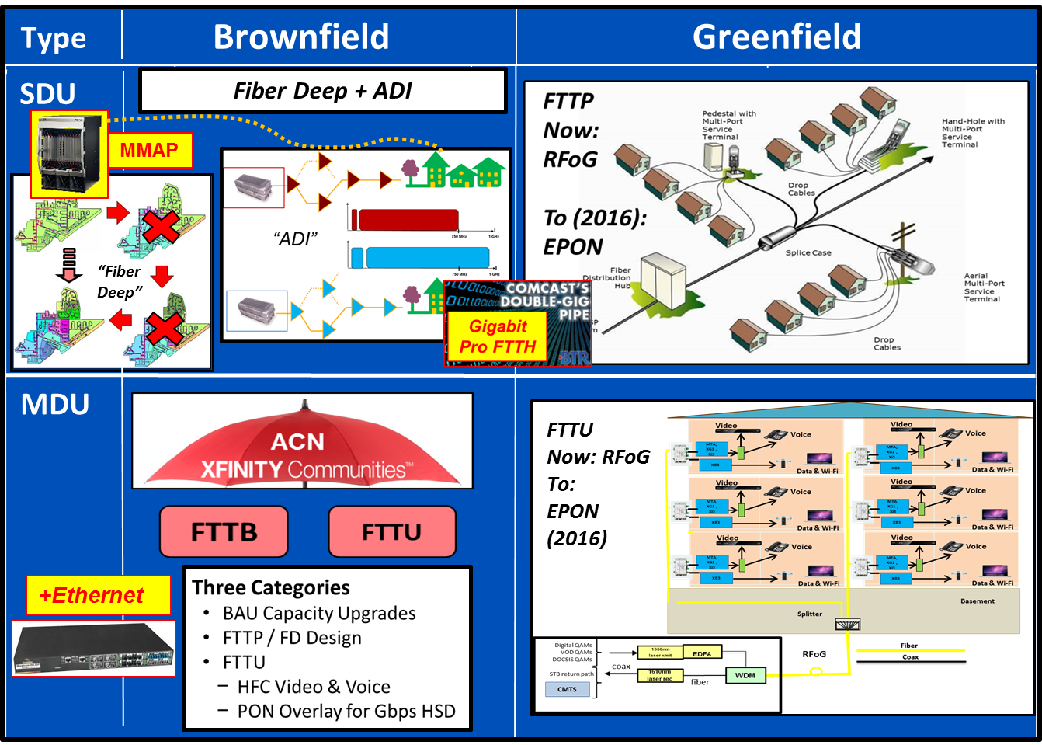
Comcast’s Access Network Strategy
DOCSIS 3.1
  Gigabit to 100% of homes
Fiber Deep HFC
  N+0 and DAA
  FDX and Virtualization
FTTP and multi-gigabit
  10G EPON ➔ NG-EPON
  MetroE and residential
FTTH for all new construction
  Master Architecture Plan
  MDU and SDU

Slide 3
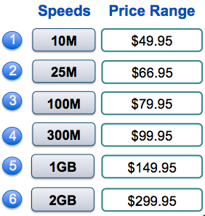
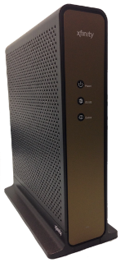
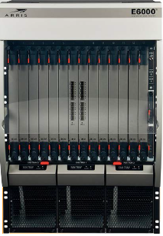
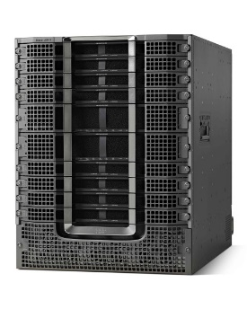
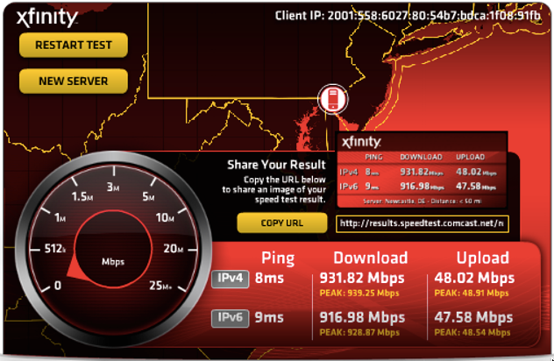
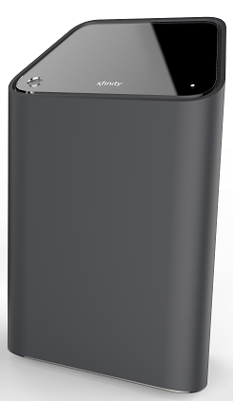
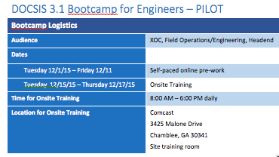
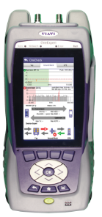

DOCSIS 3.1 - Readiness Phases
Network
Readiness
CPE
Readiness
Product Readiness
1GB Launch
MPEG4 Reclaim (<=750 MHz)
OFDM Spectrum Availability
RF Combining
CMTS HW and SW
  Arris E6000
  Cisco CBR8 w/ Gemini II
Licenses Power & Equipment
Narrowcast Lasers
CIR impact reporting (Haystack)
Installation Tool
Q2 – Retail Cable Modem
CableLabs Certified
TQM DOCSIS testing
Limited field testing
ACEA tool updated
Field Advisory
MyDevice Info
Q3 (August) – XB6
TQM DOCSIS, Voice, WiFi & feature testing
Tech, Employee & Customer trial complete
Scout/Einstein/My Account support
Systems Readiness
D3.1 supported by network tools
D3.1 Tech, Employee & Customer trials complete
D3.1 speeds & signals validated
Launch activities
OFA for new speed tier & rate codes
Speed Test Server Upgrade
Sales Approach
GTM Plan
Agent Training
Field Ops Training

Slide 4
Spectrum Allocation and Capacity
  Downstream
  Deploy D3.1 DS in available spectrum and bond with D3.0 DS channels
  Plan: 24 D3.0 SC-QAMs + 96 MHz D3.1 OFDM ≈ 900 Mbps + 800 Mbps
  Establish 1 Gbps tier from 1.7 Gbps capacity, and expand from there
  Reclaim spectrum as needed: Analog ➔ Digital ➔ MPEG-4 ➔ IP Video
Upstream
  Initially use D3.0 US capacity in current spectrum (maximize use of US)
  When available, deploy D3.1 US in all spectrum via TaFDM of D3.0 US
Legacy OOB US
Legacy
OOB DS
3-4 D3.0 Chan
Dig. Video
16-24 D3.0
Dig. Video
Future DOCSIS 3.1
Future Spectrum for DOCSIS 3.1
. . .
. . .
. . .
Initial Spectrum for DOCSIS 3.1
5
MHz
42
MHz
750
MHz
860
MHz
1,000
MHz
54 MHz
Upstream
Downstream
4-8 D3.0 Chan
Dig. Video
16-32 D3.0
Dig. Video
. . .
. . .
. . .
. . .
DOCSIS 3.1
DOCSIS 3.1
DOCSIS 3.1
5
MHz
85
MHz
750
MHz
860
MHz
1,000
MHz
1,200
MHz
102
MHz
Upstream
Downstream

Slide 5
Started trial in Philly, and now also have DOCSIS 3.1 in Atlanta, Fresno and Santa Rosa

Slide 6
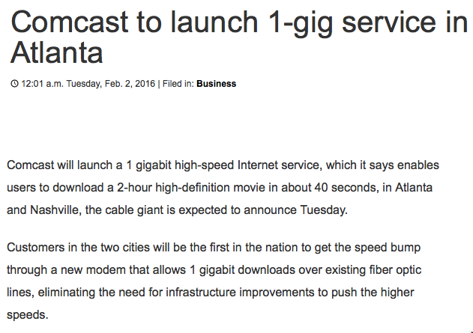
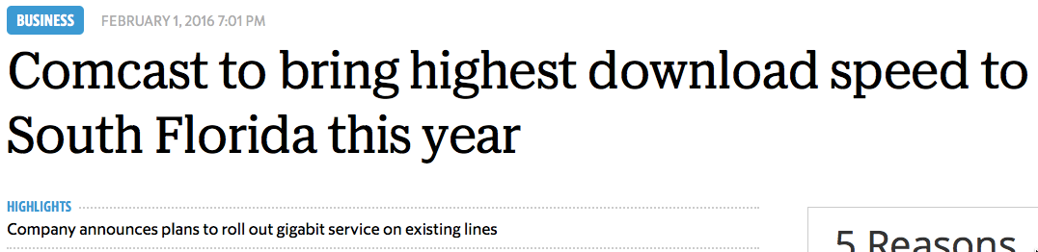
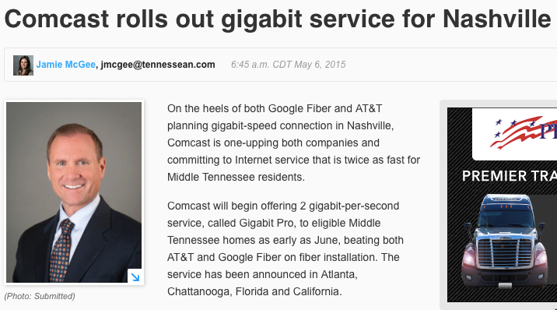
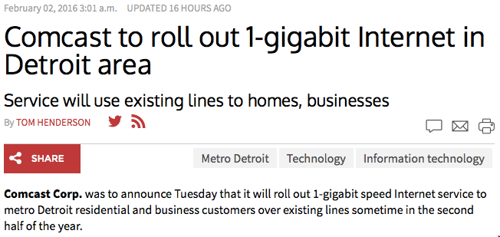
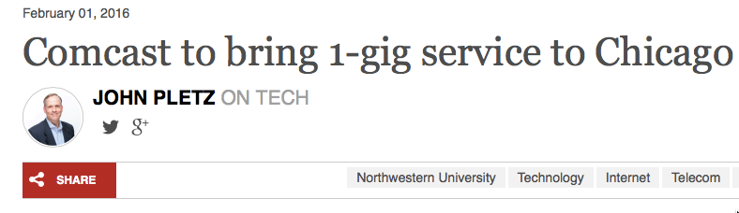
DOCSIS 3.1 deployments have begun !
Originally targeting 3Q16 for DOCSIS 3.1 deployments
However, given competitive pressures, started deployments in March with XM6-like cable modem
  Atlanta, Nashville, Chicago, Detroit, Miami

Slide 7
Comcast’s Network Technology & Deployment Strategy
Business Drivers
Technology Deployment
      MPEG4 /DOCSIS 3.1 Deployment plan
      EPON – Enables Gbit+ Symmetrical Services
      Project GRAM – Evolution to an All IP Network
      X1 Acceleration
  Fiber Deep (fiber to small neighborhoods ~100 HHP)
      Target 50% of footprint by 2022
      Market Priority based on Competitive Exposure & Intensity
  Fiber-to-the-Customer (FTTC)
      Success-Based Fiber Network Evolution Customer by Customer
      Enablement Head-End Capital ($15M)
      Staff C-MAP Network Planning & Control
      Facilitates Commercial High-Bandwidth customers
      Reorientation of Direct Sales Model
  Fiber-to-the-Home (FTTH)
      All New Build, MDU & SFU
      Enemy Trench & Construction Sharing via Municipalities & Gov’t Affairs
      Contract Driven Properties – Limited & CHQ Approved
  Fiber-to-the-Building in MDU’s (FTTB)
      Supports ACN Branding & Initiatives
      MDU Offload for Capacity Relief
      EPON Overlay/Ethernet Switched Solution
  Commercial Metro-Core Fiber Builds
      Commercial Proactive Fiber Overlays in Major Metros (aka Philadelphia)
Bandwidth Reclaim
Enables Asymmetrical- Gigabit speeds
Less Expensive CPE
Leverages existing HFC long term
+ Customer Experience - net reliability
Solid Penetration Asymmetrical Gigabit
Improved Bandwidth – forward & return
Lower OPEX (~$5 per HHP)
Supports 2Gbit product roll-out
Expands Commercial FTTX Reach
Long term network evolution strategy
Logical network build & control function
Enables Gigabit+ speeds
Brownfield competition at house level
Long term network evolution strategy
Lower OPEX over time
Fiber to the premise claims re ACN
Capacity node split relief
Fiber close to customer (2 putt)
Solution to fend off small competitors
Rapid growth of commercial footprint
Access to mid & large cap enterprise
Long term network evolution strategy
7

Slide 8
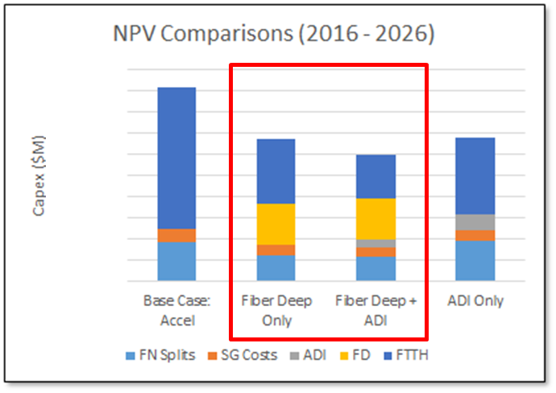
Why Fiber Deep? The 10+ Year Look
An untenable level of node splits is emerging
Initially driven by exhaustion of upstream capacity; later shifting to downstream
Build Fiber Deep with Mid-Split upstream as fast as possible for long-term capacity relief and a straightforward path to FTTH
The pace that FD can be built in practice leaves markets exposed to CAGR for many years
The FD investment must be complemented:
  Continue node splits – “Fiber Deep Only”
    Explosive growth in splits
    HSD product offering limited
  OR
  Complement with Active Drop-In – “Fiber Deep + ADI”
    More cost effective (defers and reduces node splits)
    Provides a platform for a consistent HSD product
Note: ADI includes cost of subsequent node splits
DOCSIS 3.1 is our predominant long-term capacity, speed, and IP transition technology

Slide 9
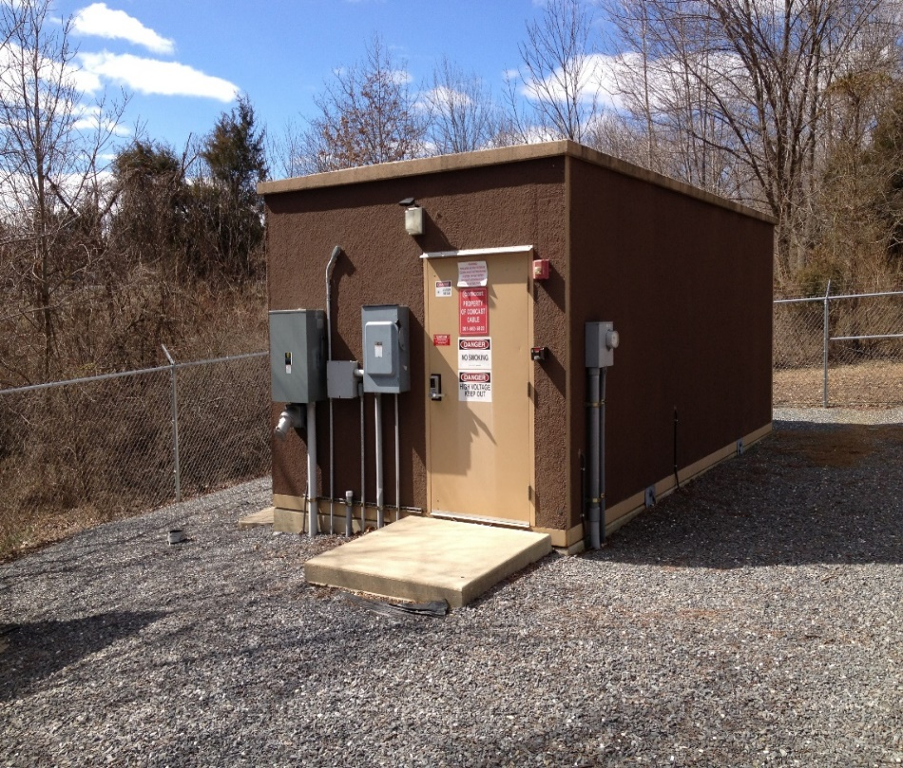
Distributed Architecture (DAA) is Key to Fiber Deep
HFC Network Benefits
Maximum Capacity of DOCSIS 3.1
Simplification of digital fiber and Ethernet vs AM
Fiber Efficiency of Digital Optics
      More wavelengths and longer reach
      Volume/cost curves of standardized digital optics
Facilities Scaling
Significant Space, Power and Cooling efficiencies
Alignment to NFV/SDN Initiatives
      “DAA fo PON” needed for HFC infrastructure
      Virtualization CCAP Core is the objective

Slide 10

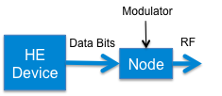
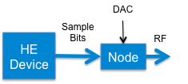

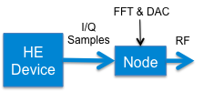
Options for Distributed Access Architecture
1. Digitize in HE and regenerate in node (used for OOB, FM, etc.)
4. Move entire PHY from HE
to node
2. Mode DAC from HE
to node
5. Move PHY and MAC from HE to node
Options 4 and 5 under vendor development
Could also miniaturize the CCAP (cDOCSIS)
3. Move lower PHY from HE
to node

Slide 11
Remote Architectures Easily Deployed
Headend
1. Deploy Linecard in HE any time
2. Migrate HFC node to DN during CM window
CCAP
Provides all broadcast and narrowcast services
DN
Same SM fiber
Maximize service group size
Minimum changes in HFC network to start

Slide 12
Digital Node Segmentation
Segment a DN without using additional fiber
Headend
Same port for multiple DNs
CCAP
Provides all broadcast and narrowcast services
DN
DN
Same SM fiber
DN
Evolve to smaller service group size as needed
Simple evolution to add narrowcast capacity
  Reuse fiber to headend
  Leverage common broadcast

Slide 13
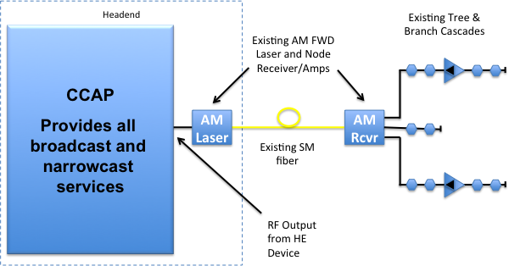
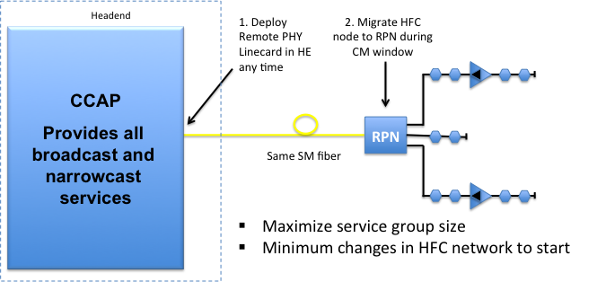
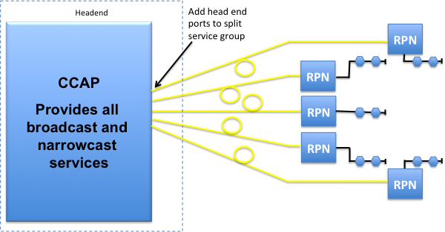
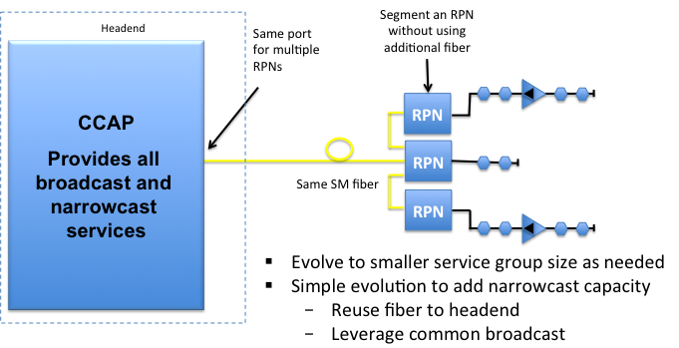
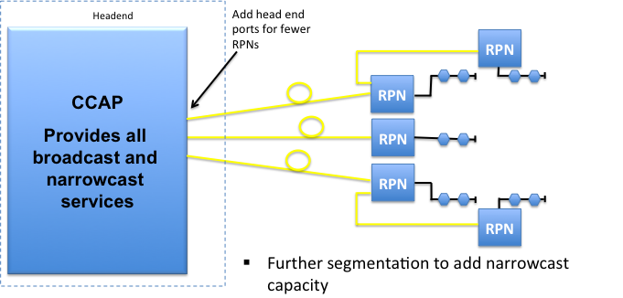
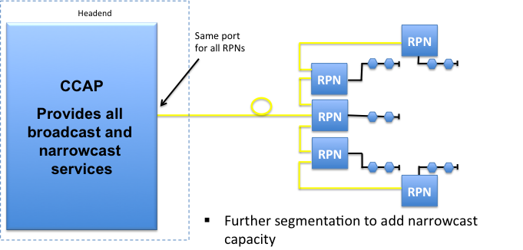
Simple and Scalable Migration
Slow gradual migration, or sudden to end state, or anywhere in between.
Scalable migration is key

Slide 14
The Road to Virtual CCAP
Remote PHY hardware for DS and US (RPD)
  Could be centralized or distributed
Other CCAP components can be virtualized (CCAP Core)
Will need big SW concepts: SDN and Orchestration
And many things will be different, once again
  More complex testing, integration and maintenance
But, we will get much higher feature velocity
  Will we have agile network implementation sprints?

Slide 15
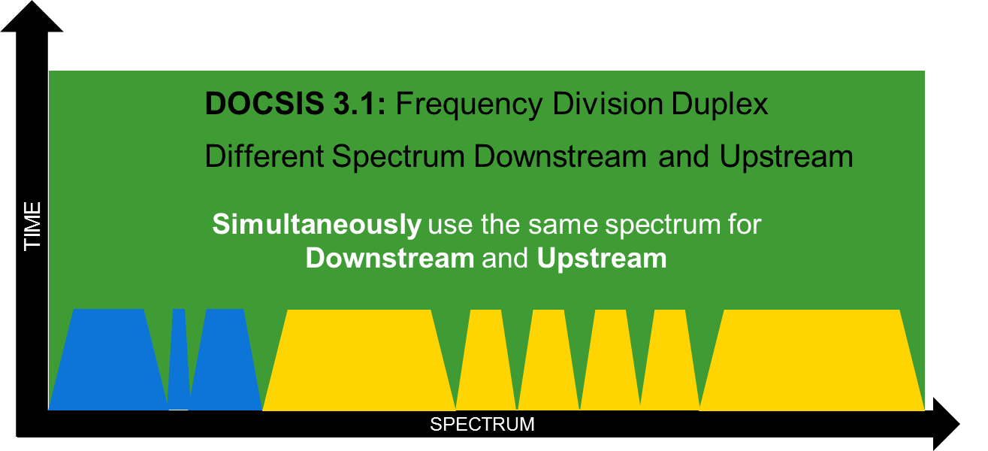
Consideration of Full Duplex
Key dependencies are ALL PoR
  Passive Coax architecture (i.e. Fiber Deep)
  Distributed Architecture
  Transition to All-IP
  DOCSIS 3.1 deployment plan
Objectives
      Service capability parity with FTTH
      Service evolution, provisioning, mgmt agnostic to last mile technology (All-IP)
      Integrate ASAP with FD DAA deployments

Slide 16
Potential of Full Duplex DOCSIS
Significantly more US capacity
  Enable very high-capacity symmetrical data services
No need to move the split to expand US
  Keep existing services in the low part of the spectrum
Backwards compatible with deployed DOCSIS
  Upgrade on a success basis, keeping other devices
Existing technology, now applicable to HFC
  Previously considered, but now seemingly feasible

Slide 17
Now in Detailed Feasibility Stage
Still in the early stages of technical development
  Investigating Full Duplex DOCSIS for about 1 year
  Discussions now expanding to a dynamic group
Applicable to certain HFC network topologies
  Passive networks, best for distributed architectures
Key areas under investigation
  Implementation of noise cancelling and applicability
  Typical passive plant characteristics and requirements
  Interoperability with existing DOCSIS 3.0/3.1 modems

Slide 18
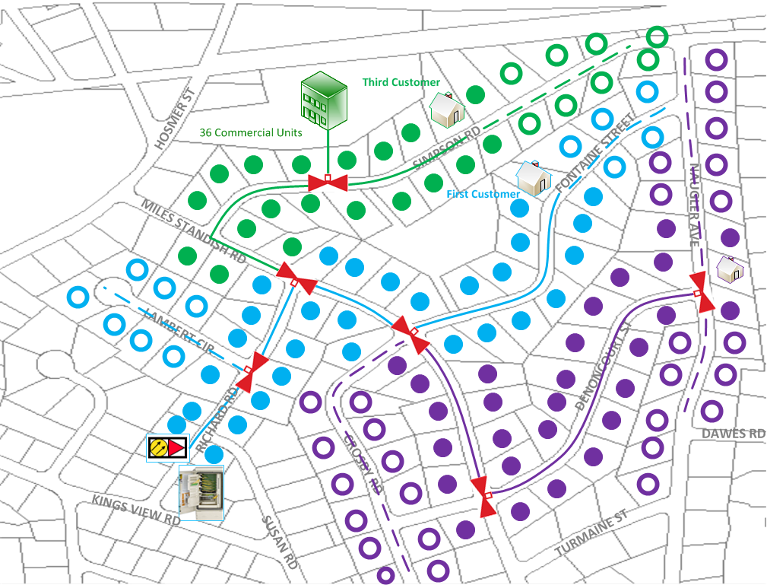
Brownfield FTTP Planned Enablement
Success-Based Build Out
Sequenced to enable entire footprint
Deployment prioritized by demand clusters
Quick and broad availability
10G EPON technology
3
1
2
18

Slide 19
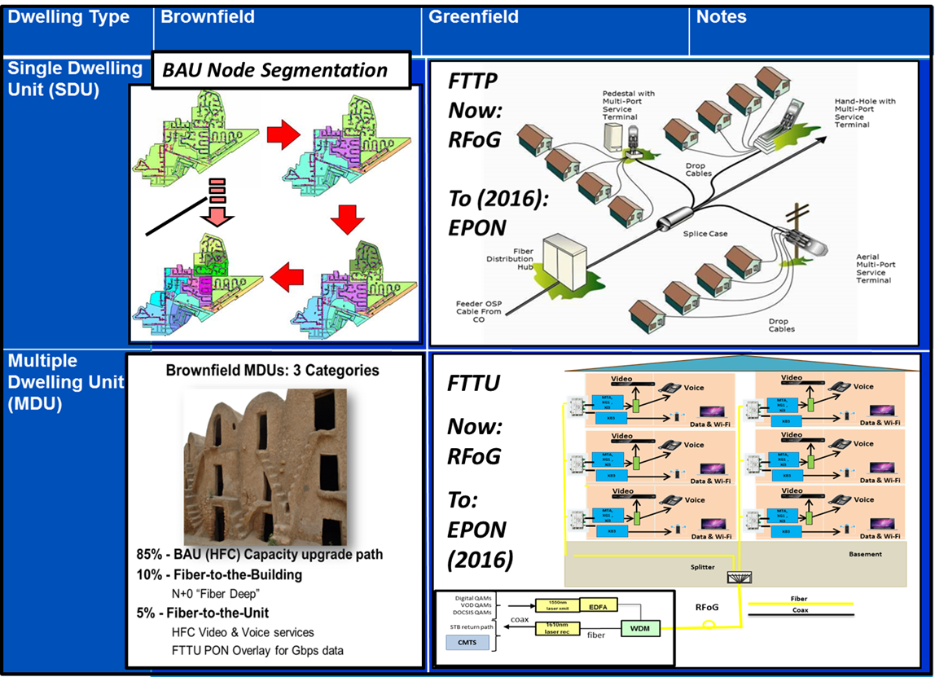
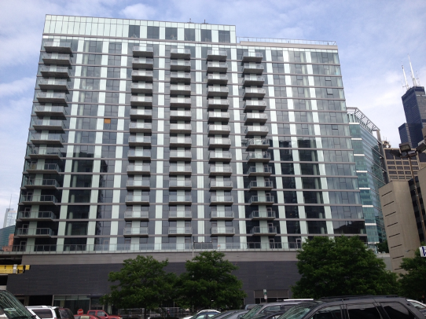

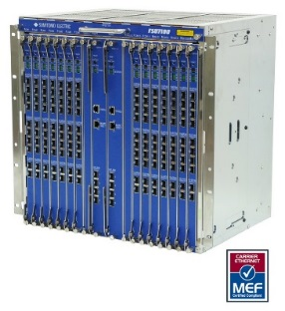
FTTP Chronology
May 2014: FTTP Plan Established
August 2014: 10G EPON Direction Selected
June-July 2014: First two FTTU Properties (RFoG installs begin - now BAU)
19

Slide 20


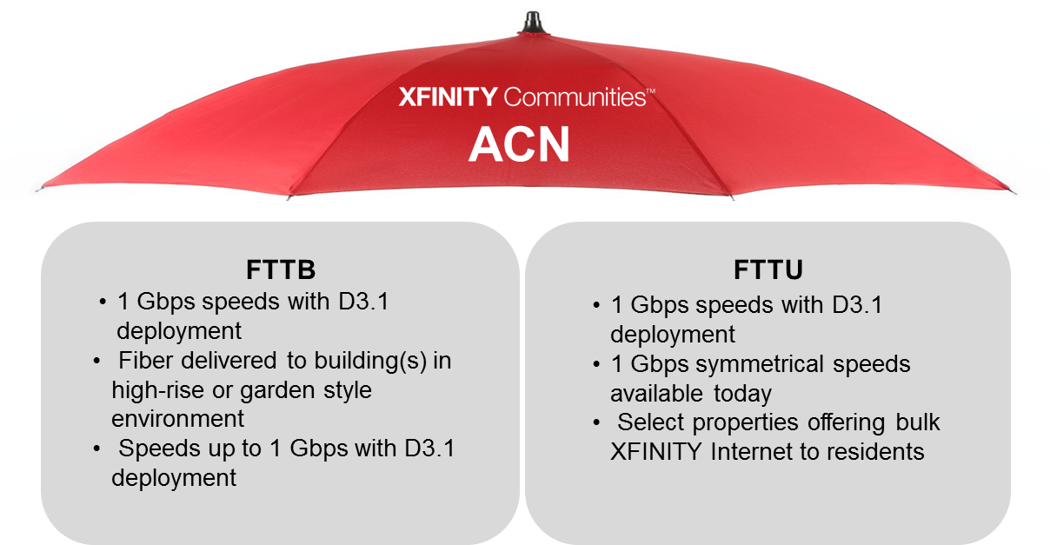
FTTP Chronology
October 2014: MDU FTTP Design & Construction Guidelines Draft Available
November 2014: 1st Gig Message Launched (ACN) at NMHC Show
Nov ‘14 – Jan ‘15: Divisional Sales, Marketing, AE Training on Gigabit and ACN
20

Slide 21
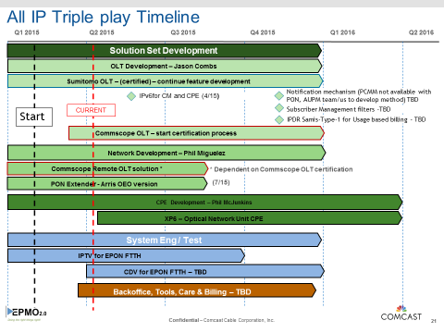
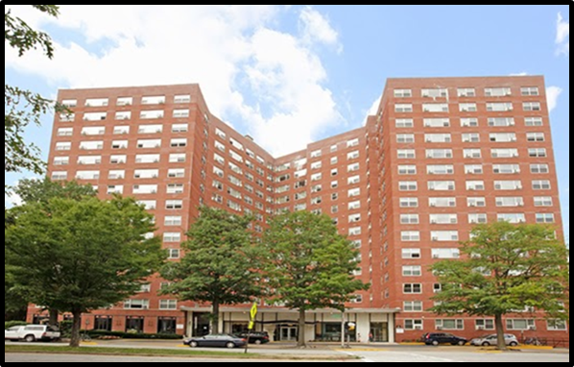
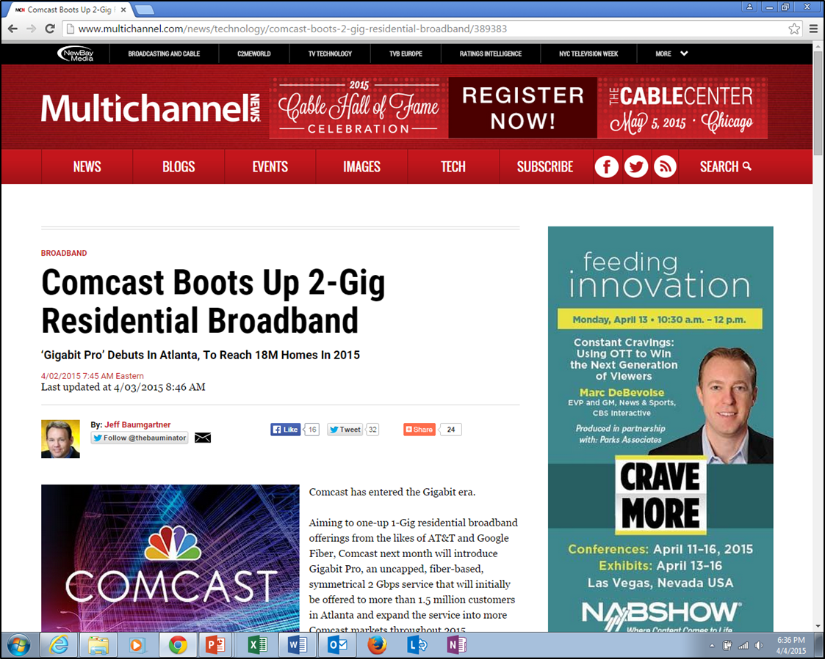
FTTP Chronology
Feb 2015: All-IP / EPON Project Kick-off
April 2015: 2Gig Symmetric (Gigabit Pro) Announced
March 2015: 1st PON Installation begins (trial)
21

Slide 22
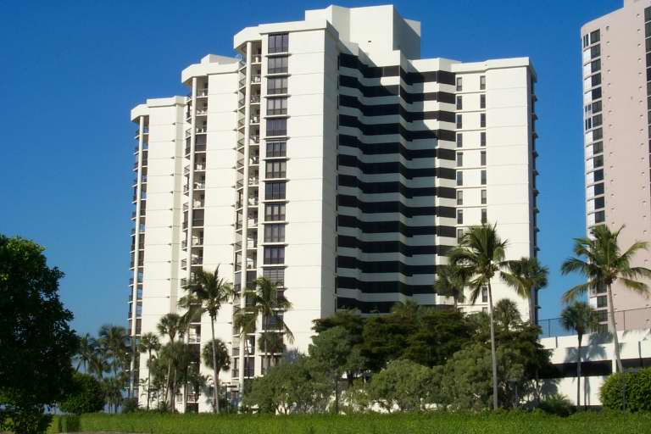
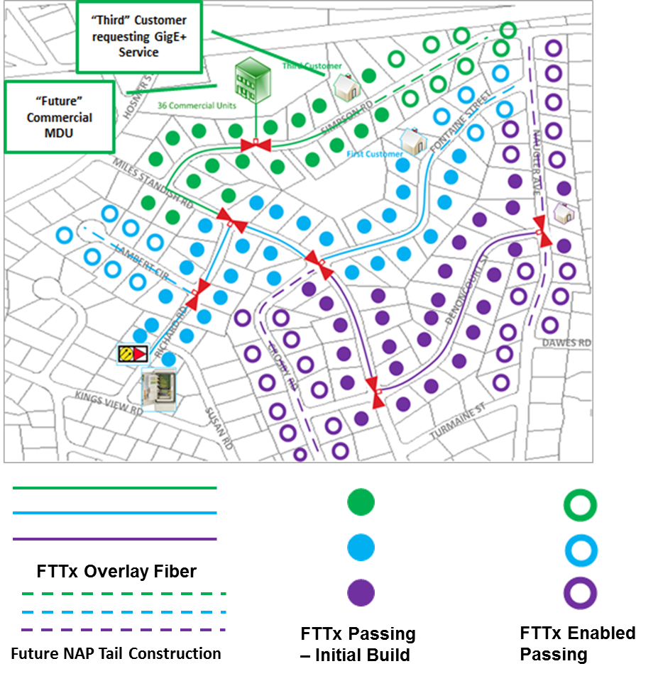
FTTP Chronology
May 2015: 1st PON Bulk deal win (Naples, FL)
June 2015: Success-based FTTH investment / network (MMAP)
22

Slide 23
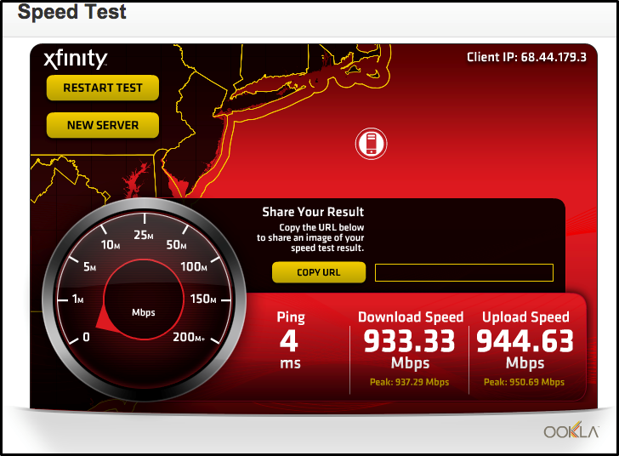
FTTP Chronology
September 2015: First paying PON customers turned up (HFC + PON HSD)
“The Esplanade,” Naples, Florida
2016: Many more deployments moving forward
23

Slide 24

10G/10G EPON Selected
Lead competition, not follow
Emerging technology over legacy
Support wide scale symmetric service tiers: 100/100, 300/300, 1000/1000
Enable Multi-Gbps – Growth beyond 1G
Match DS capacity of future HFC
Take advantage of DPoE and integration experience
10G is a cost over reach for small overbuild competition
10G cost curve stimulated
Supports high penetration of 1G speeds
Ability to drive NG EPON timeline aligned to our needs
24

Slide 25
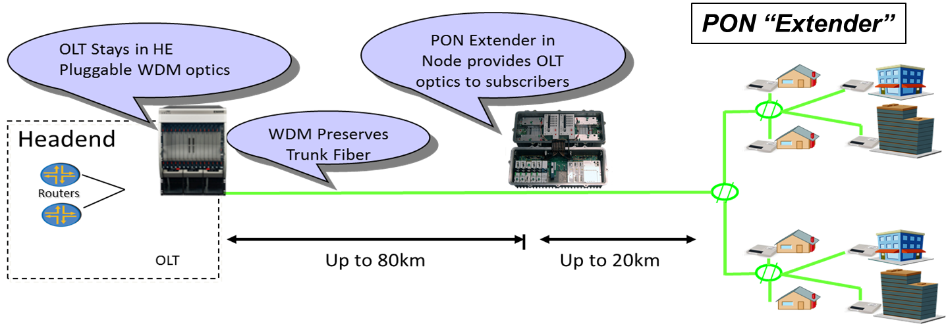
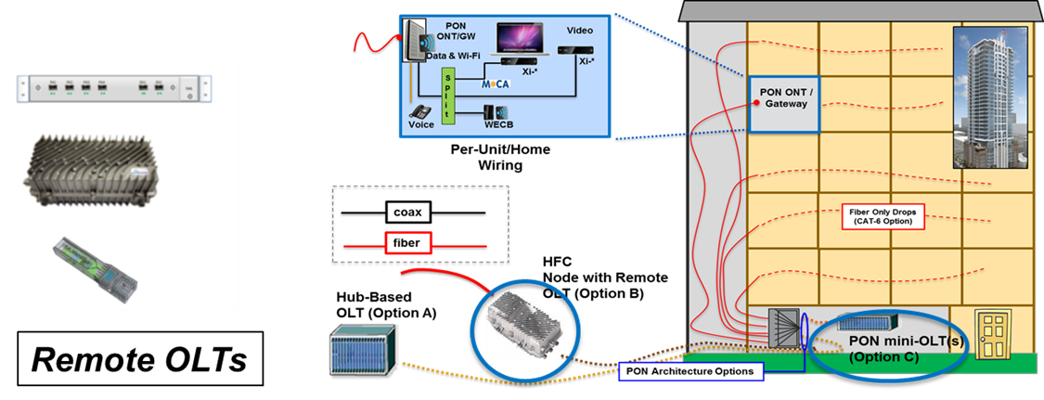
PON Architecture Components for Cable
25

Slide 26

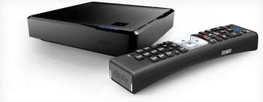




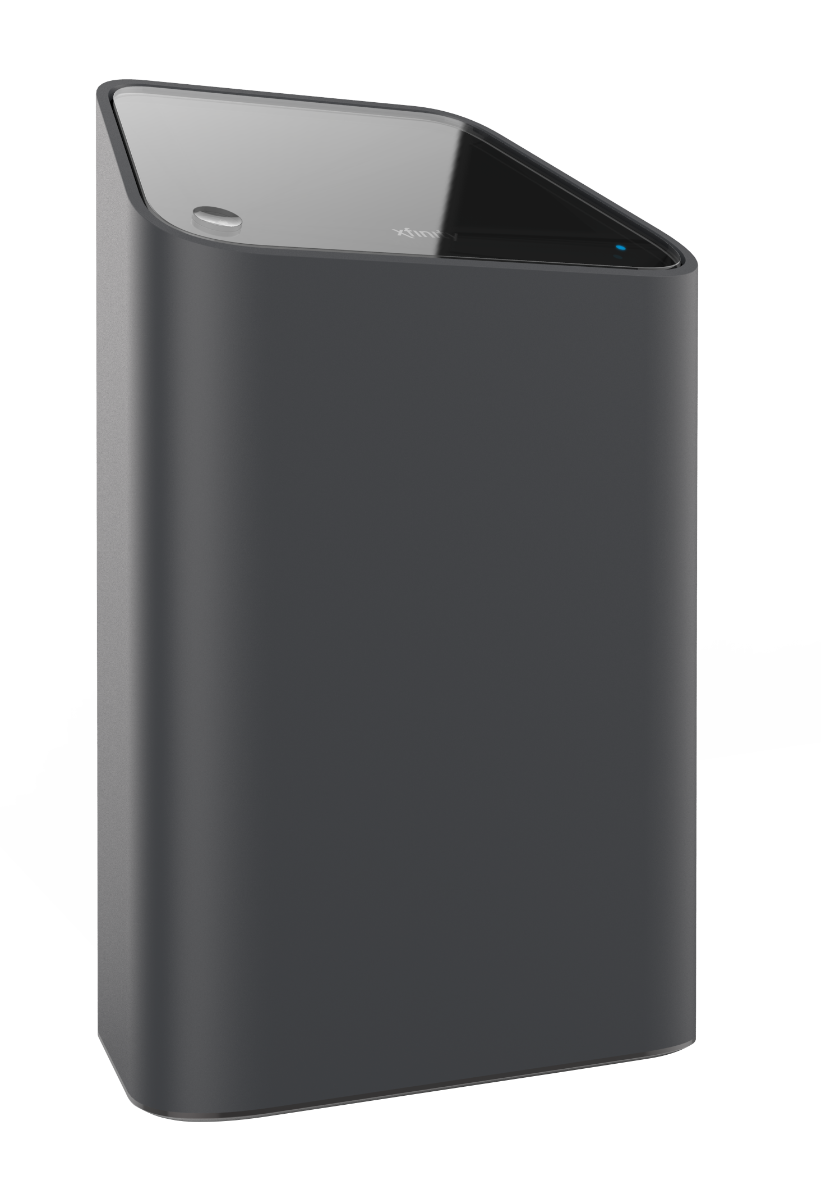

Gram: All-IP Content Delivery
2014: HYBRID QAM / IP INTRODUCTION
XG1
All Channel
IP encoding
QAM
IP
Cloud DVR
HYBRID QAM / IP
VOD to XI3
Xi3
IP
ENTIRE VOD
Library in IP
IP Delivery
cDVR to 2nd screen
2015: START IP UNICAST
Linear, VOD & cDVR
to ANY Screen
XB3/XB6
IP
Xi3/XiD
EPON deployment is more reliant on rapidly transitioning to all-IP delivery than the HFC network
Unicast IP
Trials/ Early DEPLOYMENTs
2016: MULTICAST ALL-IP
XB6/XP6
IP
Xi5
IP Channel Multicast
All-IP Gateway
26

Slide 27
Do we use Unicast or Multicast? Answer: both
CDN
Multicast reduces access network capacity for most popular content
Unicast used for all content not being multicasted
  VOD and cDVR
  Long tail linear
Unicast is the back-up for reliable video delivery
Approach is transparent to all types of client players
  Player is unaware of multicast
  All players receive unicast
  Multicast works for any client
Unicast
MC Server/Controller
Multicast
CMTS
Gateway
MC GW Client
Player
Multicast
Unicast

Slide 28
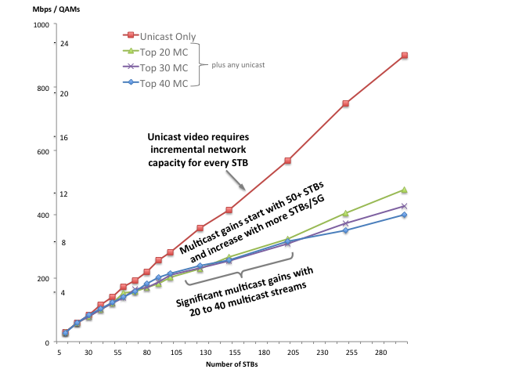
Network Capacity Benefit from Multicast
Savings
Benefit starts with about 50 clients and is even bigger with 100-200
Significant savings from multicast just 20 most popular programs

Slide 29




IP Video on EPON/DPoE Systems
DOCSIS OSS
Servers
CM/GW
IPv4 Host
MC Coordinator
DNS
IPv6 Host
CMTS
HFC Network
DHCP
IPv4 Host
MC Server
TFTP
MDC
IPv6 Host
SNMP
CDN
ONU/GW
MDC
IPv4 Host
IPDR
Syslog
IP Network
R
OLT
IPv6 Host
ODN Network
Time
IPv4 Host
Virtual CM
(vCM)
IPv6 Host
DPoE System
Multicast works for both DOCSIS® and EPON/DPoE networks
In EPON, SG is smaller, so capacity benefit is greater in RAN

Slide 30
Next Gen EPON – IEEE Standard
Phase 1: Industry Connections (not all projects) - DONE
  Outcome was a long report outlining need
  Took 1 year, approved in March, 2015
Phase 2: Call For Interest - DONE
  Defines interest to create a new standard
  Took 1 interval, approved during July plenary
Phase 3: Study Group - DONE
  Defines Objectives, Qualification Criteria & PAR
  25G, 50G and 100G EPON
Phase 4: Task Force - Started in January ’16 - WIP
  Task Force approved following November meeting
  Project is called 802.3ca

Slide 31
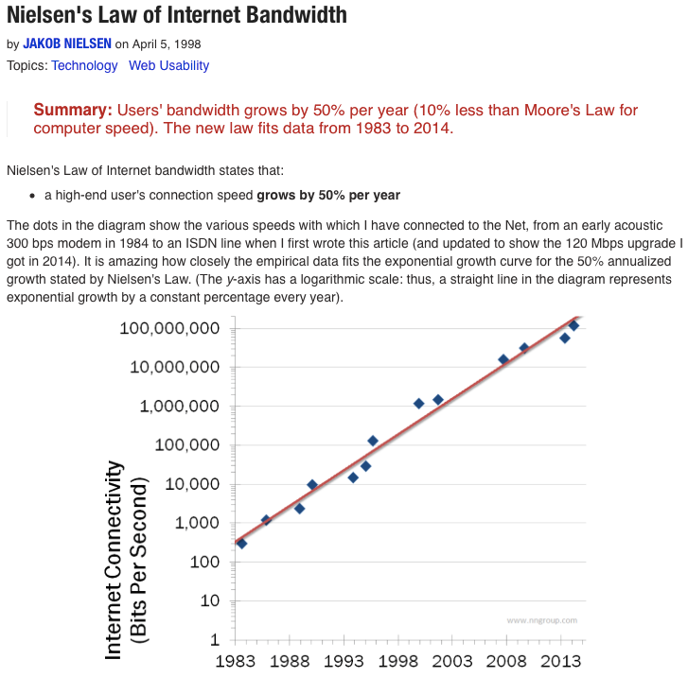
Nielsen’s Internet Use Growth Rate: 50% YoY
Empirical data from almost 20 years has very well tracked this theory. However, it does not clearly differentiate peak speed growth from usage growth rate.
Source: Nielsen Norman Group

Slide 32
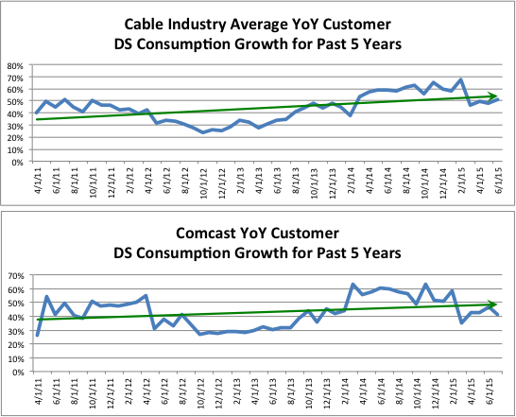
Observed Usage Growth Rate: 40-60% YoY
NG-EPON CFI Presentation (ngepon_cfi_R19 - Slide 17)
NG-EPON SG Presentation (ngepon-1509-salinger-1 – Slide 5)

Slide 33
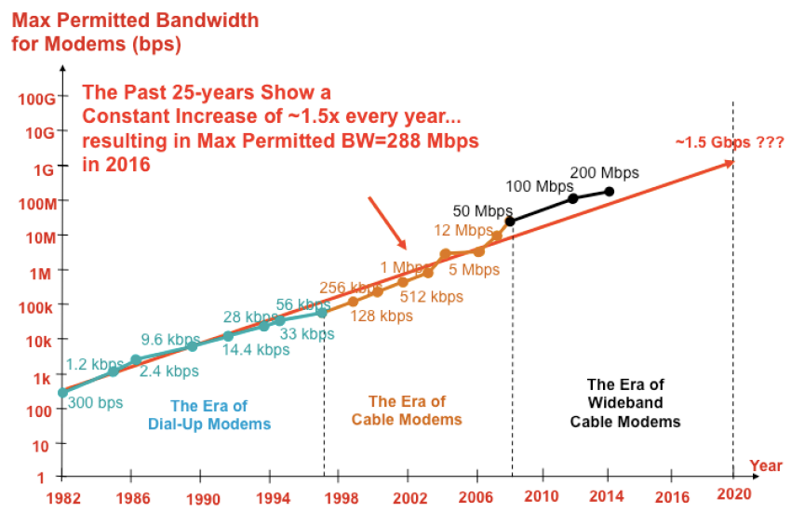
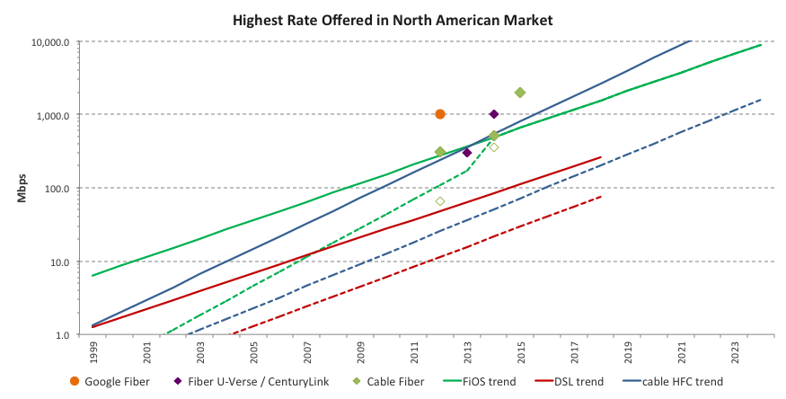
Offered Peak Speed Growth Rate: 50% YoY
NG-EPON ICAD Report
(ng_epon_report – Figure 17)
NG-EPON SG Presentation (ngepon-1509-salinger-1 – Slide 8)

Slide 34
Peak Speed Growth YoY Projection
Year | Peak Speed Projection
2014 | 1 Gbps (Actual)
2015 | 2 Gbps (Actual)
2016 | 3 Gbps
2017 | 5 Gbps
2018 | 7 Gbps
2019 | 10 Gbps
2020 | 15 Gbps
2021 | 22 Gbps
2022 | 33 Gbps
2023 | 50 Gbps
2024 | 75 Gbps
2025 | >100 Gbps
10G EPON Capacity No Longer Effective

Slide 35
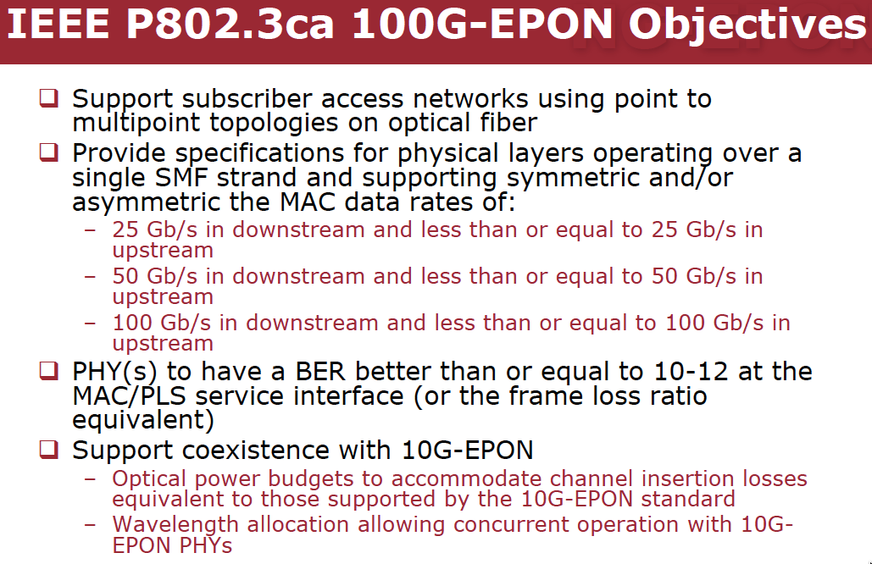
NG-EPON Objectives and Process
We don’t need 100G to start in 2019
Everyone agrees that we should develop a scalable technology
The above objectives present significant challenges for the TF to tackle
As a team, we worked through Call For Interest and Study Group with a timeline in mind
  We targeted CFI presentation and SG Objectives, Criteria and PAR to meeting dates

Slide 36
Summary
Gigabit has become a core service component
DOCSIS 3.1 is the primary platform for gigabit services
All new construction is being implemented as FTTH
10G EPON deployments for MDU and SDU
Continue MetroE commercial services in entire footprint
Multi-gigabit services for residential and commercial subs
Long-term architecture plan
  HFC evolution – Fiber Deep, DAA, Virtualization and Full Duplex
  Near-term, success-based FTTH deployment and GigPro
  Long-term transition to FTTH throughout the footprint
  Support +10-yr capacity and product expectations – NG-EPON
This is as exciting as it gets in access networks!
36

Slide 37
Thank You !!
Questions, Comments or Suggestions?
Jorge Salinger
VP, Access Architecture
jorge_salinger@cable.comcast.com

