Slide 1
Congreso TEPAL - 2017
Comcast’s Access Network Strategy
Jorge Salinger
VP, Access Architecture

Slide 2

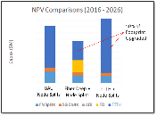
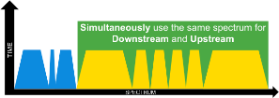
Comcast’s Access Network Plan Components
DOCSIS® 3.1
  Gigabit to 100% of homes via HFC
Fiber Deep
  More cost effective than node splits and FTTH
  Additional capacity for DOCSIS 3.1
Distributed Architectures
  More efficient HE architecture and better DOCSIS 3.1 performance
Full Duplex DOCSIS
  Enable multi-gigabit upstream capacity
Fiber to the Home/Premise
  Resi new build, RFoG/10G EPON/NG EPON, biz MetroE services, 2 Gig

Slide 3
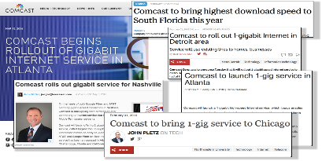

DOCSIS® 3.1 Deployment Underway at Comcast
Few 1.0/1.1
Lots of 2.0
Some 3.0
Remove 1.0/1.1
More 3.0
Many 3.0
Begin deploy 3.1
Lots of 3.0
More 3.1
Lots of 3.1
CPE Devices
Initial D3.0
Broad D3.0
3.1 CPE
3.1 DS CCAP
3.1 US CCAP
HE Equipment
5-42/65 MHz US
3.0 CMTS
DS Bonding
Legacy OOB
3.0 CCAP
More DS Bonding
US Bonding
S-CDMA
3.0 CCAP
More DS & US bonding
3.1 CCAP
Begin 3.1 DS
Expand DS
Begin 3.1 US OFDMA
Here now
3
Notes:
HD

Slide 4
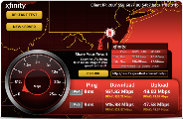


Comcast’s Focus on DOCSIS 3.1
Target DOCSIS 3.1 to 100% of the Comcast footprint
  Very large plan in execution across all regions
  35% in 2016 - 70% in 2017 – rest in 2018
Started deployment with XB6 gateway
  Initiated deployment in 2016 with TC4400-CMT
Service installation tools are very important
  New tools to measure OFDM channel performance
  Optimize CCAP config with Profile Management System
  Technical & operational changes from DOCSIS 3.0
Training is fundamental to develop understanding
  Qualify customer’s equipment
  Provide speed testing capable of Gigabit speeds
4

Slide 5
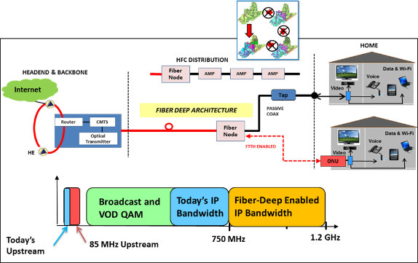
Fiber Deep: Primary HFC Evolution Tool
Passive coax
More spectrum
Flexible spectrum
Smaller serving groups
Convenient access for FTTP
Cost effective long-term approach
5

Slide 6
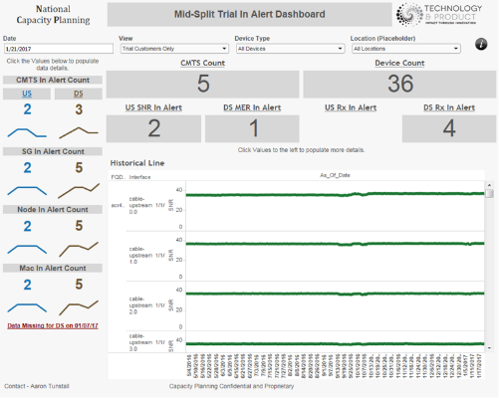
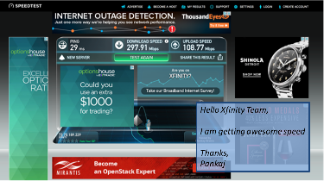
Fiber Deep 85 MHz Mid-Split – Customer Trial Live Today
October 2016 kicked-off in West Division
Use of “Special’ 85 MHz-capable XB3
First actual use of >42 MHz with XB6 availability (switchable diplexer)
Estimate in 2H ‘17 will have the capability to offer a 100 Mbps services in Fiber Deep markets to D3.1 1G customers
6

Slide 7
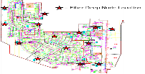



Fiber Deep is Awesome . . . But . . .
+10x Fiber Deep nodes
Very small service groups
Very efficient for narrowcast
Fiber within 1K ft of homes
Architecture | Space Utilization
Today Non-Fiber Deep Gen 1 Line Cards | ~10 Racks All-in
Today Fiber Deep CCAP Gen 1 Line Cards | 3x To 4x
RPHY or RMACPHY Plus HW Core | Less Than Today
RPHY or RMACPHY Plus Virtualized Core | Even Less Space
Current Approach
Significant Scalability of Facilities
Fiber Efficiency and Better Performance
Simplicity of Ethernet Connectivity
DAA
7

Slide 8
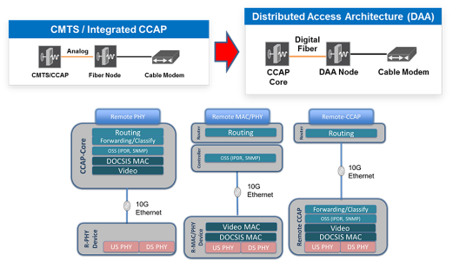

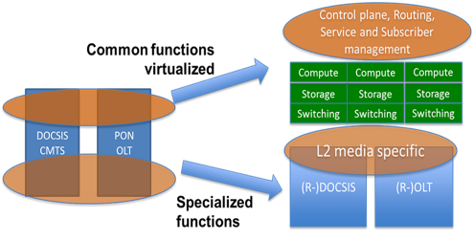
Strategic Pivot to Distributed Access (DAA)
Distributed Access
Ethernet Connectivity
Fiber Reach
Fiber Efficiency
D3.1 Performance
Alignment to NFV / SDN Transition
Scalability of Facilities
Last Mile Access Agnostic
Virtualized Distributed Access
8

Slide 9
Phases and Aspects of R-PHY Development
1. Base Implementation
2. Core-RPD/RPS Interoperability
Develop RPD
Same Interfaces
Separate PHY
CMTS Core 1
RPD 1
Address non-vendor-specific interaction
No exact match of CCAP, Node and Encryption footprint
Need one vendor’s R-PHY with another vendor’s Core
Core
RPD/RPS
CMTS Core 2
RPD 2
Implement Interfaces
Timing
Control plane
Data plane
vCMTS
RPD 3
3. Two Use Cases
4. Generations
Fiber Deep
Features for each case
Spectrum difference DS and US
Capacity and performance differences
Different device architecture
In Progress
2018 / 2019
2019
RPD
Gen 1
Gen 2
Gen 3
Core
Current silicon
Already in Development
Mid-2017 initial field trial and deploy late ’17
Designed to support FDX
Eventually implement RDK-n
Available ASAP
Optimize components & power
RPD
BAU HFC
9

Slide 10
Remote PHY Development in Progress
Comcast working with multiple vendors since 1Q16
  Work underway to implement interfaces and develop operational functionality
  Have nodes and cores from multiple vendors in multiple labs
Comcast Targets:
  Trials in 3Q17, Small-scale deployment in 4Q17, Full-scale by 1/1/18
CableLabs Interops underway since November, 2016
  Monthly events (6th next week)
  Extensive GCP, R-DTI and DEPI, some UEPI
OOB implementation well underway
  SCTE 55-1 DS with all vendors and US with 2 vendors
  Code from Broadcom; now scaling
Leakage Detection also well underway
  Working Group with several node/CMTS vendors and tool companies
  Specified RPD requirements for all participating vendors
10

Slide 11
Remote PHY Development in Progress
Spectrum Surveillance work underway
  Replacement for tools such as PathTrack; monitor US for ingress detection
Started work on Sweep (FWD and RTN)
  Need to be compatible with field tech tools
Developing test/integration tools
  Ethernet Sniffer:
    Monitor and debug interface between CMTS Core and RPD
    Comcast funded; in use by all vendors and CableLabs; available to everyone
  RPD Reference Design
    Based on OpenRPD – not required for interoperability
    Intended for positive and negative testing of CMTS Cores
  Core Reference Design
    3 Approaches Available: Broadcom Triton/Atlas, Vector Emulator, Tool from Altera/Capacicom
    Intended for positive and negative testing of RPDs
11

Slide 12
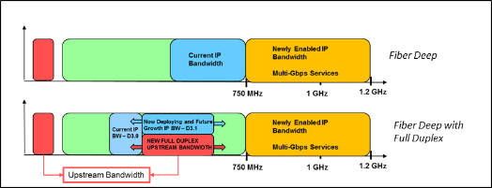

Fiber Deep + RPHY: Enabler of “Full Duplex” DOCSIS
Key dependencies are Comcast PoR
  Passive Coax (i.e. Fiber Deep)
  Distributed Architecture (DAA)
  Transition to All-IP
  DOCSIS 3.1 deployment plan
Key Objectives
      Order of magnitude improvement in upstream capacity and speeds without extending split into Downstream spectrum
      Services agnostic to last mile access technology or medium
      Integrate with Fiber Deep DAA deployments ASAP
      Gig Symmetric competitive - Brownfield MDU, future IoT capacity
Key Upcoming Activities
3Q’16 | 4Q’16 | 1Q’17 | 2Q’17 | 3Q’17 | 4Q’17 | 1Q’18 | 2Q’18 | 3Q’18 | 4Q’18 | 2019
MSO Requirements Finalized
FDX Standards Finalized
Proposed Maxlinear ASIC availability
Silicon Ready for Testing
Gig US / HFC
FDX CableLabs Kickoff
12

Slide 13
Motivation
DOCSIS 3.1 provides multi-gigabit downstream, now in deployment
  Competition drove message for gigabit symmetrical services
  Full Duplex adds the remaining piece – multi-gigabit US
Full Duplex provides significantly more US capacity
  Enables multi-gigabit symmetrical data services from 1st generation
No need to move the split to expand US capacity
  Keep existing DOCSIS services in the low part of the spectrum
Backwards compatible with deployed DOCSIS
  Upgrade on a success basis, keeping other deployed devices
Existing technology, now applicable to HFC
  Previously considered, but only now seemingly feasible
13

Slide 14
Assumptions for Full Duplex Operation
Plant
  Passive HFC network for Full Duplex DOCSIS (Fiber Deep, N+0)
  Fiber Deep node contains a DAA module (R-PHY or R-MACPHY)
  Highest possible port-to-port tap isolation
  FDX CPE terminates HFC network
Spectrum
  FDX uses D3.1 downstream and new upstream channel definition
  FDX US transmissions use spectrum allocated to DOCSIS 3.1 DS
  Spectrum allocated to QAM video or legacy DOCSIS not used for FDX
FDX CM receives OR transmits at any time
DAA/CMTS simultaneously receives and transmits
14

Slide 15
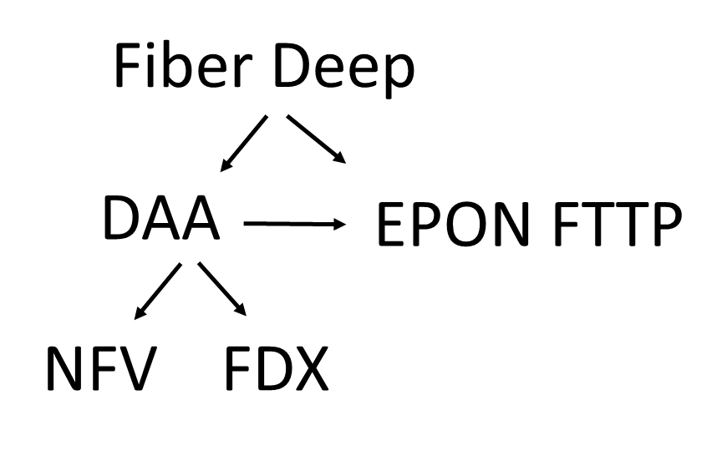

Synergistic Relationships
More evolution in the access network now and in 2-3 years than in the past 20 years !!
15

Slide 16

Questions?
Thank You !
Jorge Salinger
VP, Access Architecture
jorge_salinger@cable.comcast.com

